Slide 1
Clean Code

Slide 2
목차
1. Software Craftsmanship
2. Clean Code & Refactoring
3. Test Code Smells & Refactoring
4. Legacy Code

Slide 3
1. Software Craftsmanship

Slide 4
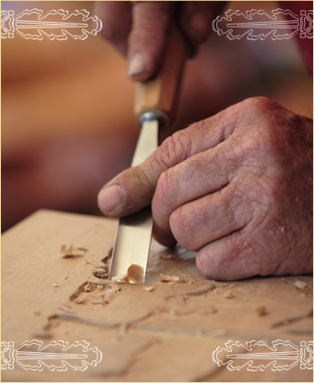
1.1 Software Craftsmen
Software Craftsmen
just care
beautiful code

Slide 5
1.2 Agile Software Development
We are uncovering better ways of developing software by doing it and helping others do it. Through this work we have come to value:
Individuals and interactions over processes and tools Working software over comprehensive documentation Customer collaboration over contract negotiation Responding to change over following a plan
That is, while there is value in the items on the right, we value the items on the left more.
Notes:
Working on an agile environment? Messy code? Manifesto?
Feb 2001, Skiing Utah, 17 ppl: - XP, Scrum, DSDM, Adaptive S/w Dev, Crystal, Feature DD, PragProg >> Uncle Bob, K Beck, A Cockburn, W Cunning, M Fowler, A Hunt, D Thomas, R Jeffries, B Marick, K Schwaber, J Sutterland
Agile Alliance formed, Conferences started.
Alternative to Doc Based, heavy weight methodologies
Who is working on an agile environment?
Who still works with messy code after doing agile for a few years?
On February 2001, seventeen people representing XP, Scrum, DSDM, Adaptive Software Development, Crystal, Feature-Driven Development, Pragmatic Programming and others met in a ski resort in Utah to search for an alternative for documentation driven, heavy weight software development. They were: Kent Beck, Mike Beedle, Arie van Bennekum, Alistair Cockburn, Ward Cunningham, Martin Fowler, James Grenning, Jim Highsmith, Andrew Hunt, Ron Jeffries, Jon Kern, Brian Marick, Robert C. Martin, Steve Mellor, Ken Schwaber, Jeff Sutherland, Dave Thomas.
The Agile Alliance was formed and Agile Conferences started.

Slide 6
1.2 Agile Software Development
We adopted Agile and now things will be OK
… and the Agile Transformation Era began.
Notes:
Agile transformations, Get better, Scrum mainstream.
Stand-up, Burn down, Backlogs, Agile coaches, Iterations, User stories, White board
Post-its
All over the world, companies and teams started adopting Agile, with the hope that they would produce quality software. And the Agile Transformation Era began. “We need to do better, we need to improve”. Scrum became mainstream. Teams started having Scrum meetings every day, product backlogs, iteration backlogs, started working on an interactive way, burn down charts, requirement documents became user stories, white board with sticky notes became part of the office's furniture.

Slide 7
1.2 Agile Software Development
And then we spend 10 year focusing on...
… people, interactions, team building, the ecosystem
Process and Interactions became more important than technical practices
Notes:
Focus: Process, People, Bureaucracy, Waste
Real problems
Process over technical practices
Over the years, companies and agile coaches focused on the process. They focused in the ecosystem, people interactions, removing unnecessary bureaucracy. People empowerment. Important problems that needed to be solved. And then Agile took a de-tour and Process became more important than technical practices and excellence.

Slide 8
1.3 The Agile Hangover
Many Agile projects are now, steadily and iteratively,
producing crap mediocre software.
Notes:
Old problems: Long cycles, Bugs, QA teams, Technical Debt
shit pilling up every iteration
TECHNICAL DEBT STORY – New feature
At least now we can see where we are
TOYOTA DREAM
And than it happened. Projects were still failing or not delivering the value expected. Same old problems. Features were still taking forever to be developed and deployed into production. Dedicated testing teams and testing cycles were still in place. Loads of bugs. Technical debt impeding teams to progress. (Mention TECHNICAL DEBT STORY – new feature) But it's not all bad news. At least now we can see it getting worse and worse
TOYOTA DREAM. Would Toyota be successful if they were producing shit cars?

Slide 9
1.3 The Agile Hangover
We want to get things done...
… but we are under pressure
Notes:
Unfair for me to say
No one wakes up in the morning…
Cut corners under pressure
There’s always pressure
Want to get things done
No one wakes up one morning and say: “Today I'm gonna write some crap code. Today I'm gonna let my team down writing horrible code. Today I'm gonna do my worst.”
However, under pressure we ended up cutting corners. And we do that because we want to deliver, we want to get things done.

Slide 10
1.3 The Agile Hangover
The wrong notion of time
Notes:
Planning / Estimation – Make s/w better
Waste: Debug, understand code
Package >> Deploy >> Test >> LOGs >> Debug (start over)
Big IF statement, global variable
Other ppl have time: QA, other devs, weeks, years (cuz we don’t have time)
Developers have a complete wrong notion of time. We give the ESTIMATIONS but DON'T PLAN for making our SYSTEM BETTER. “WE DON'T HAVE TIME” to do something. They were responsible for the estimations and they think they don't have time. But, do they have time for DEBUGGING the code? To RUN A FULL BUILD, DEPLOY the application and MANUALLY NAVIGATE through the system for everything they want to change or add to the system. Do they have time to TEST ALL OTHER AREAS of the system that may have been impacted by this change? If they don't test, that means that other people are spending time doing it. Maybe a full TESTING TEAM. What about the OTHER DEVELOPERS, when they try to UNDERSTAND THE CODE you've written. They also have a lot of time to do the same thing? All the developers, all the testers, WEEK AFTER WEEK, MONTH AFTER MONTH? Can we imagine how much time is that? How much time we spend debugging and testing the application? Just because we “don't have time” to write and automate our tests?

Slide 11
1.3 The Agile Hangover
But what is to be Agile anyway?
Notes:
QUICK & SMALL FEEDBACK LOOP
Be Agile: Narrow loop (make problems visible) and react (adapt process, empower ppl)
Agile doesn’t solve problems / Exposes it.
Shorter & quicker feedback loop, more agile you can become
Agile is about feedback. QUICK AND SMALL FEEDBACK LOOP. It's about constantly NARROWING the feedback loop.
Now teams have a quicker feedback about their progress. WE CAN SEE that we are NOT GOING as WELL as we expected. We can see PROBLEMS arising. We can ADAPT OUR PROCESS. We can EMPOWER PEOPLE to do their work.
The shorter and quicker the feedback loop is, the more agile you can become.

Slide 12
1.4 The invisible threat
Code
quality
Time per feature
Notes:
Low quality: Difficult to see in burndown charts – Splitting stories
CANCER, HOSTAGE
Maintain quality at all costs – Go fast, Go Well
GARDENING
Difficult to see that with burndown charts and backlogs
Like CANCER, when you notice it is too late
Some people say that they just don't have time to do it properly but, in general, a lot more time and money is spent later on on tests and bug fixing.
HOSTAGE of your own software
To keep business progress, schedule and budget under control, HIGH QUALITY code needs to be MAINTAINED AT ALL COST.
Rather than construction, programming is more like GARDENING.

Slide 13
1.5 Manifesto for Software Craftsmanship - raising the bar
As aspiring Software Craftsmen we are raising the bar of professional software development by practising it and helping others learn the craft. Through this work we have come to value:
Not only working software,
but also well-crafted software
Not only responding to change,
but also steadily adding value
Not only individuals and interactions,
but also a community of professionals
Not only customer collaboration,
but also productive partnerships
Notes:
2008 – Some of the Agile creators
Uncle Bob, Ron Jeffries.
Something was wrong with Agile.
Bad: Working code not good enough. Legacy system. Scared to touch – BREAK IT. Don’t have a clue. Difficult to test. Massive undertake.
Good: Easy to understand. Testable (automated – press button). Express business domain. Regardless how old
TMOBILE
1.Well-crafted software: Working code is just not good enough. Think about the applications you work on a daily basis. All the LEGACY SYSTEMS. How many times we DONT'T HAVE A CLUE what the code does. How many times we are SCARED TO TOUCH the existing code because we don't know if we are GOING TO BREAK IT. Writing TESTS for the EXISTING CODE is a MASIVE UNDERTAKE since it takes forever. We want good, quality code. Code that is easy to understand, that we can PRESS A BUTTON and after a few seconds or minutes we know if there is anything wrong with it. We want to UNDERSTAND what the CODE does just LOOKING AT THE TESTS at all levels. And all this, REGARDLESS HOW OLD the application is.
Not just employees / Do what we are told / Keep head down
Provide solutions / Help clients achieve / Question requirements / Do what is needed
Reputation / We are stakeholders
Clients not ready for partnership (TMOBILE STORY)
Not just bug fixing / new features
Improve structure; Keep clean / tested; Velocity doesn’t drop;
ASSET / ROI >> DECOMMISION (5 years)
Increase value / does not rot
2.Steadily Adding Value: This is NOT JUST adding new FEATURES or changing existing one. This is NOT about BUG FIXING. This is about CONSTANTLY IMPROVE the STRUCTURE of the code, KEEP the code CLEAN, TESTED so our VELOCITY doesn't DECREASE over time and we stop adding as much VALUE as we were at the BEGINNING of the PROJECT. The SOFTWARE must be seen as an ASSET and the constant maintenance of the code will make it more VALUABLE DURING ITS LIFETIME, instead of letting it rot and devalue.
Share ideas
Prepare next generation
Mentor
Share successes and failures
3.Community of professionals: This is what we are doing here today. We are expected to SHARE our IDEAS and PREPARE the NEXT GENERATION. It's our duty to MENTOR less experienced developers and help our industry to LEARN from all our MISTAKES and SUCCESSES. COMMUNITIES and USER GROUPS are essential for a healthy future of our industry.
4. Productive partnerships: We are NOT SIMPLE EMPLOYEES. We are PROFESSIONALS. We are NOT there to DO what WE ARE TOLD. We are there to PROVIDE SOLUTIONS, HELP our CLIENTS to ACHIEVE whatever they want to achieve. As professionals we have a REPUTATION TO CARE about and this reputation is totally RELATED to how we work with OUR CLIENTS. We are the main STAKEHOLDERS in a software project BECAUSE it is OUR REPUTATION that is on the line. NOT GETTING INVOLVED with the business, not questioning requirements, not helping on tasks that are not related to development but are related to the project, IS NOT A PARTNERSHIP. However, you may say, SOME CLIENTS are NOT READY for that and they will not “allow” you to get closer or to do anything that is not development. So in this case, they don't want the partnership and I don't think they will have software craftsmen working for them for too long.

Slide 14
1.5 What is Software Craftsmanship?
Software Craftsmanship is all about putting
responsibility, professionalism, pragmatism
and pride back into software development
Notes:
Software craftsmanship is about professionalism.

Slide 15
1.5 What is Software Craftsmanship?
Does context matter?
Does it always matter?
Notes:
You don’t know my company. It’s different. Excuse.
Not context specific: Quality, Tests, Bugs, Velocity, Agility
Many people will say: “But you don't know the context. My company is different, my project is different. In our case, according to our context, craftsmanship does not apply. You don't understand the constraints and pressure we have”. Yes, context matters, but are there practices that don't depend on context?
ARE THERE CASES WHERE QUALITY DOES NOT MATTER? BUGS? RELIABILITY? EASY TO MAINTAIN? CRAP CODE IS OK?

Slide 16
1.5 What is Software Craftsmanship?
How do we know we are
building the right thing?
How do we know we are
building the thing right?
Notes:
FEEDBACK AGAIN: Quicker & Smaller, the better.
Agile vs Craftsmanship
How to get feedback on the quality of our software?
Not visible through burndown charts
This is about FEEDBACK again. The QUICKER and SMALLER the FEEDBACK LOOP is, the better. With Agile processes we can know if we are building the right thing, but how do we know if we are building it right? Just looking at burn down charts in terms of features, we can't see it. And when we realise the CODE has DETERIORATE, normally it is ALREADY TOO LATE. We don't slow down abruptly. We slow down in a very gentle pace.

Slide 17
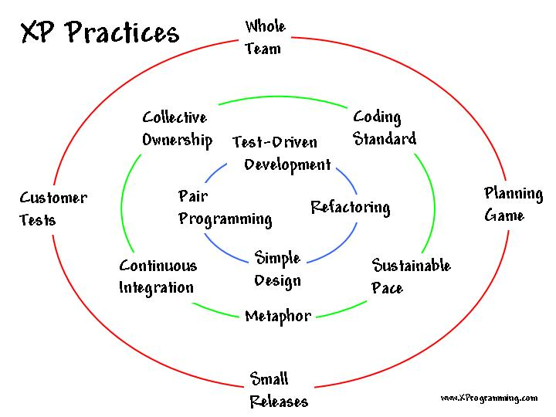
1.5 XP Practices
Notes:
Goes back almost 15 years.
Inner circle – Not context specific
Forgotten during Agile transformation
Add value / Quick & Small Feedback loop – Agile sense.
When we talk about context, are the practices in the INNER CIRCLES CONTEXT SPECIFIC? Why these practices were forgotten or not emphasised during agile transformations? Those PRACTICES ADD VALUE, providing a quick and small FEEDBACK LOOP. They are key for us to know if we are BUILDING THE THING RIGHT.

Slide 18
1.6 Adding value through practices
Automated testing
Test first
Test-Driven Development
Pair-programming
Continuous Integration
Notes:
Automated Test: Click button, Regression Test (Value, Feedback)
Test First: Think out ideas, Define API, Focus
TDD: All Levels, De-coupling, Design, Feedback, Documentation
Pair: Names, Duplication, Knowledge Share
CI: Team work (FEEDBACK, VALUE)
1. Automated testing: We click a button and in a few minutes we know if the system works or not. It give us regression test suite. That's value. That's short and quick feedback loop.
2. Test first: Help to think out ideas. Help to focus on the problem we are trying to solve. How we interact with the system. Are the API's useful? Is the code useful?
3. Test-Driven Development: Focus on de-coupling (modular design); focus on cleanliness; RED >> GREEN >> REFACTOR; Constant feedback on the quality of your code. SIMPLE DESIGN.
4. Pair-programming: Constant feedback on names; extra eyes to notice DUPLICATION; knowledge sharing
5. Continuous integration: Feedback on team work; Quick indication of incompatible changes; That's how we get feedback if someone (or yourself) broke the code.

Slide 19
1.6 Adding value through practices
Don't discuss practices,
discuss value.
Notes:
Corey Haines
What you do that is better than this?
How long is the feedback loop?
Code review vs Pair
Whenever someone questions these practices or don't want to do them we should ask: How are your practices adding this value? What are you doing that is better than this? How long is your feedback loop?

Slide 20
1.7 Healthy Intolerance
How can you add more value and/or have smaller feedback cycles when not using our practices?
Notes:
When some says: I’m not going to do XYZ
Justify decisions we make and DONT MAKE.
How’s your practices any better?
We need to JUSTIFY the DECISIONS WE MAKE. When someone comes to you and says “I'm not going to do something”, we need to ask them: We have these practices that give value in an Agile fashion, shrinking the feedback loop down. If you are not going to do a practice that we do know, how do your practice provide quick feedback? How is your practice better? How is your practice adding the same value?

Slide 21
1.8 Practices
Mastering the practices is hard …
… and that's why we practice
Notes:
TDD is hard.
Production drops (WE ARE NOT GOOD ENOUGH) – J CURVE
Musicians
Not expected to practice – Provide value instead
Learning TDD, automated testing, pair-programming is hard. PRODUCTION DROPS. You will slow down at the beginning as you do every time you are learning something. But the benefits of it are enormous. And that's why we practice. Like musicians that practice before the concert, we practice.
DRIVING A CAR
Like other professionals, we are NOT EXPECTED to PRACTICE during WORKING HOURS. We are expected to PROVIDE VALUE.

Slide 22
1.8 Practices
Perfect practice
(narrowing the gap)
Notes:
Corey Haines
GAP – WE SUCK (Imagine if you had all the time in the world..)
Internalise concepts / technologies >> DO WELL UNDER PRESSURE
Come naturally
DRIVING
Imagine you have all the time in the world, all the knowledge in the world. Image what would be your idea of good and quality code. And now imagine what you do in your day-to-day job. This gap measures how much you suck. And we all do. Practising is a way to reduce this gap. Practise helps us to internalise concepts and techniques so the next time we are at work, under pressure, good solutions (names, tests, etc) will flow more naturally. It's not practice that leads to perfection, it is perfect practice that leads to perfection. When practising, try to do you best. Try naming variables and attributes properly, spend as much time you need to write your test and doing refactoring. You don't need to deliver when you are practising. Focus on the techniques.

Slide 23
1.8 Practices
Software Craftsmanship is a long journey to mastery
Notes:
For each step towards mastery, the further away you get from it
No certifications >> Peer Recognition
Failure to be a developer
Enjoy the journey >> Development is awesome
For each step towards mastery, the further away we get from it. You don't decide if you are a master or not. This is something that you can't achieve with certifications. A master craftsman needs to be recognised by other software craftsman. Mastery is something that very few of us will achieve but the road to it is an amazing one. So, my advice is: “enjoy your journey”.

Slide 24
1.9 Software Craftsmanship Attitude
- Owning your career
- Not a 9 to 5 profession
- Practice
- Boy scout rule
- Expecting promotions
Notes:
Career: Don’t rely on companies; Doctors, Solicitors, Accounts; PRAFULLA
9 to 5: Study Hard – Not paid for it – Be ready
Practice: Katas, Dojos, Pet-Projects-Communities
Promotions: 2nd Year
1. Owning your career: Don't rely on COMPANIES to give you TRAINING. Spend your own time and money on getting better as a professional. Mention DOCTORS, SOLICITORS, DENTISTS, REPUTATION, etc.
2. Not a 9 to 5 profession: If you think you STUDIED HARD at UNIVERSITY, sorry to say but that was a piece of cake. It will just get worse. We are not paid to study or practice. We are paid to do the work. It's UP TO US to keep ourselves UP TO DATE with new technologies and techniques.
3. Practice: Katas, dojos, user group and communities, reading, PET-PROJECT, open source
4. Boy scout rule: Always leave the camp ground cleaner than you found it.
5. Problem is the second year.

Slide 25
1.9 Software Craftsmanship Attitude
The attitude towards
legacy code
Notes:
How many of you work with legacy code? How many enjoy?
Used to hate it
Pile of shit follows you everywhere
Jigsaw Puzzle – Love the challenge
I used to hate it. I was miserable, always complaining, moaning and cursing. However, over the time I realised that this would not make my life easier or better. I had to do something about it. Today I look at it as a challenge. And I like to be challenged. I make it personal. I challenge myself to understand it. To make it better. I challenge myself to be able to write tests for it. I treat it as a big jigsaw puzzle. Start isolating the corners, than the edges, then grouping pieces by colour or pattern. Then you start putting a few pieces together. The more pieces you put together, the more excited you become. You want to do more, it gets easier, and being able to see part of the picture keeps you motivated to see the full picture. That's what working with legacy code is for me today. Love the challenge.

Slide 26
1.9 Software Craftsmanship Attitude
Why would we want to be better
developers?
Notes:
Disease to learn
Be proud; Reputation; Delight customers; Deliver Value
First because we have this DISEASE where if we don't learn something every day our BRAINS DETERIORATE and we DIE. Besides that, we want to be BETTER PROFESSIONALS. We want to DELIVER, we want to IMPRESS OUR CUSTOMERS, delivering VALUE. REPUTATION.

Slide 27
1.9 Software Craftsmanship Attitude
Software Craftsmanship is not...
… a church, trying to convert all developers
It's about leading by example and showing how we can be better
… about beautiful code
It's about continuously delivering value not writing crap code
Notes:
Frustration convincing others – Not for everyone
Loads will keep producing CRAP
… a church: Forget about trying to CONVINCE EVERYONE to be a software craftsman. You will be FRUSTRADE. Software craftsmanship is NOT FOR EVERYBODY. Not every developer out there will have this attitude towards their profession. Not all of them will be practising and getting better and many of them will still PRODUCE loads of CRAP without a minimum CONSIDERATION for their CLIENTS. But how do WE DEAL with that? We LEAD BY EXAMPLE, we show how we can DISTINGUISH OURSELVES. We show we are the COOL KIDS. Hopefully other developers will joining in because they can SEE OUR PASSION, the QUALITY and SPEED we DELIVER and how HAPPY we are.
… about beautiful code: It's about being professional and adding value.

Slide 28
1.9 Software Craftsmanship Attitude
Stop...
… being miserable and negative
… spreading your frustrations
Notes:
Impact morale >> Junior; New Hires
Leave the company – It’s your life
LOOK AT THINGS AS CHALLENGES NOT PROBLEMS
… being miserable and negative
… spreading your frustrations
As developers, mainly the senior developers, we have a responsibility of not being negative. We should always keep the team's morale up. Seniors being negative and frustrated cause a big impact in the morale of the team. Juniors are looking up to you and as soon as they see you frustrated or being negative, they will also be frustrated and negative. We should LOOK AT THINGS AS CHALLENGES NOT PROBLEMS.

Slide 29
1.9 Software Craftsmanship Attitude
The only way to have people
buying into what you believe
is if they see you happy.
Notes:
Can’t force change in attitude
Show how happy you are
Be an example
Lead by example, make people feel that they want to be like you. CHANGING SOMEONE'S ATTITUDE is not an easy task. You CAN'T FORCE it. They will need to want to change their attitude.

Slide 30
1.9 Software Craftsmanship Attitude
Craftsmanship is not enough
to guarantee the success of
a project but the lack of it can be the main cause of its
failure
Notes:
If some companies don't want to invest on a team of craftsmen, well, good luck for them in their projects.

Slide 31
Agile and Craftsmanship complement each other and both are necessary.
Agile processes assume technical excellence and a professional attitude.
Software Craftsmanship takes technical excellence and professionalism to a whole new level.
Notes:
Agile and Craftsmanship complement each other and both are important. Craftsmanship take technical excellence and professionalism to a whole new level.

Slide 32
2. Clean Code & Refactoring

Slide 33
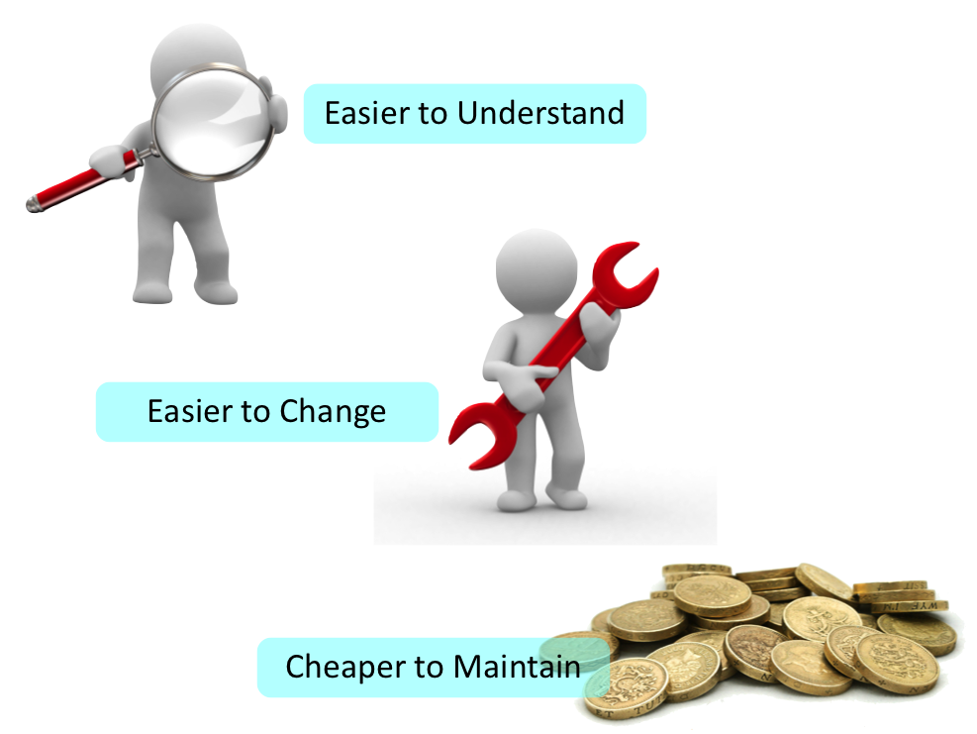
2.1 Clean Code?‏

Slide 34
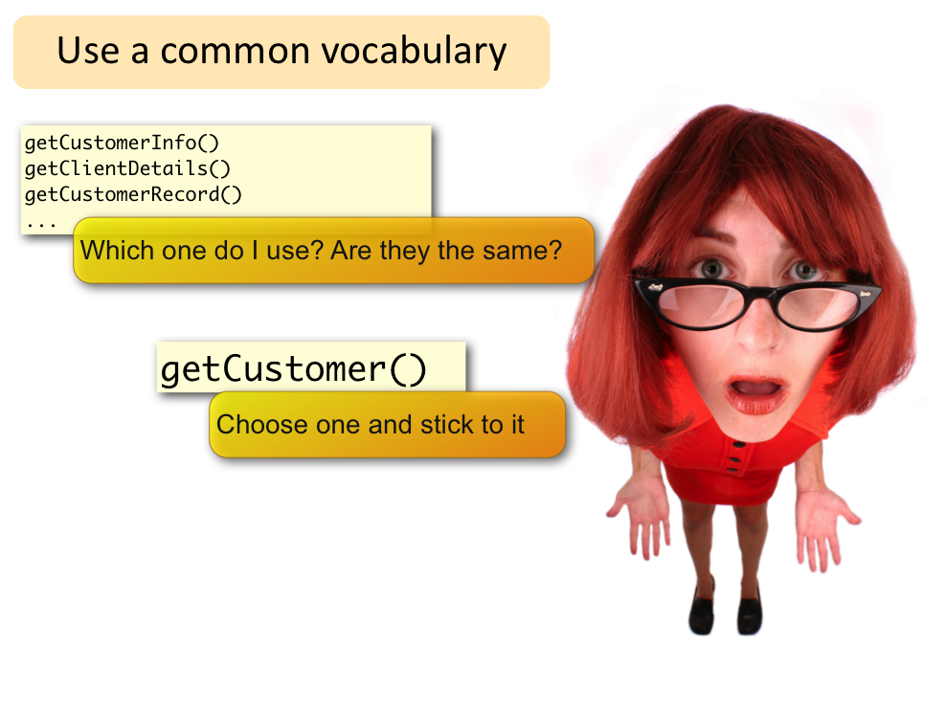
2.2 Clean Code‏

Slide 35
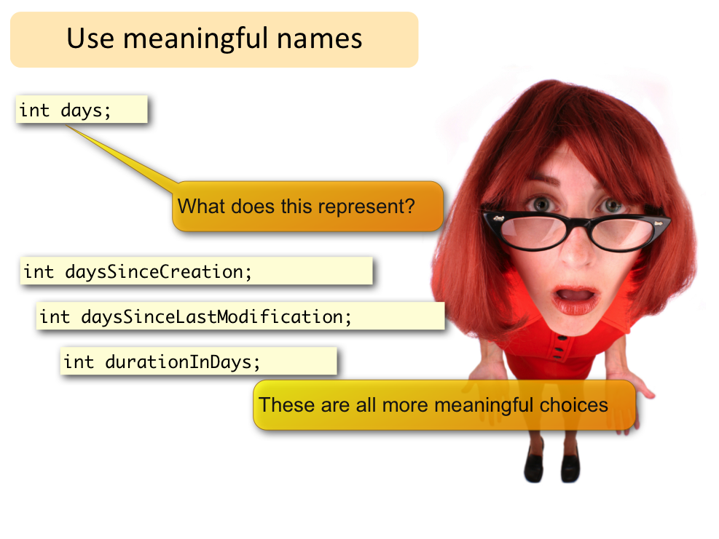
2.2 Clean Code‏

Slide 36
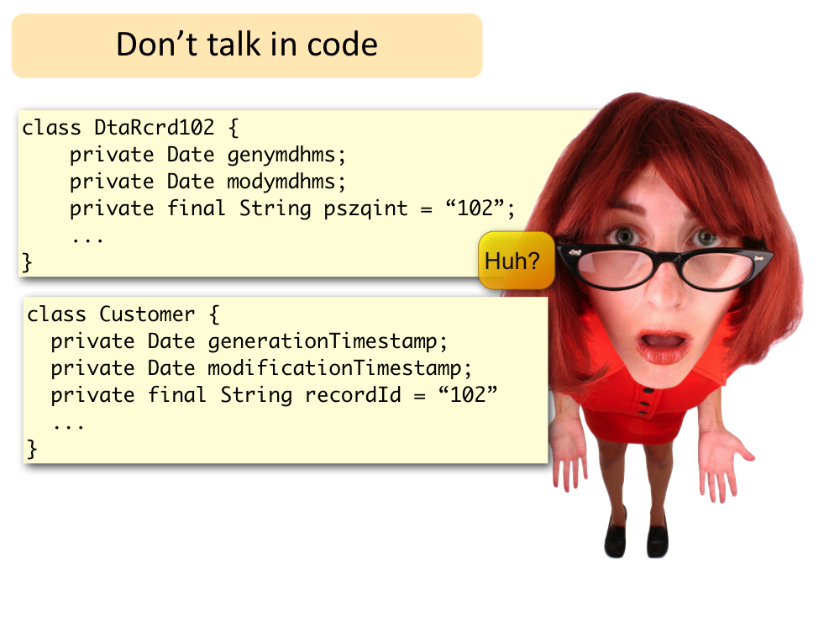
2.2 Clean Code‏

Slide 37
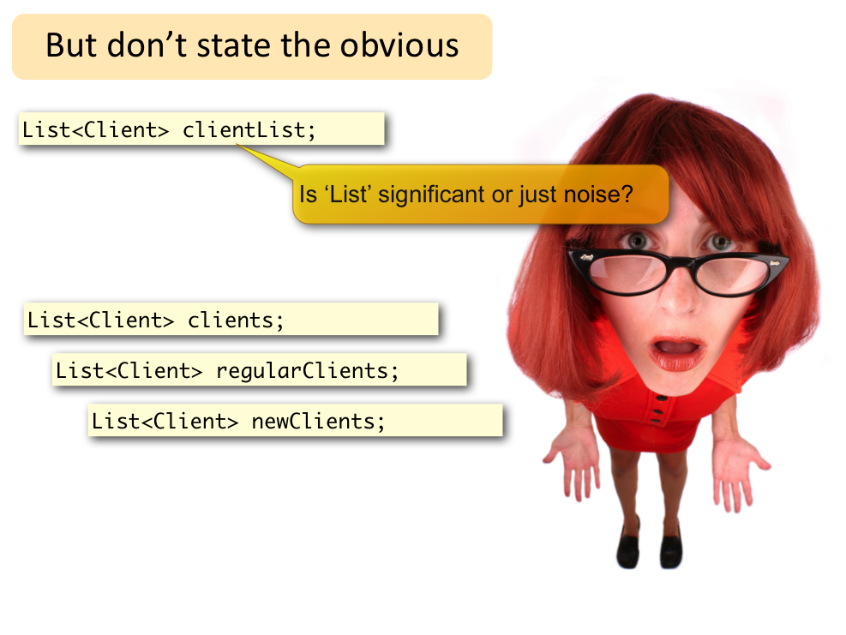
2.2 Clean Code‏

Slide 38
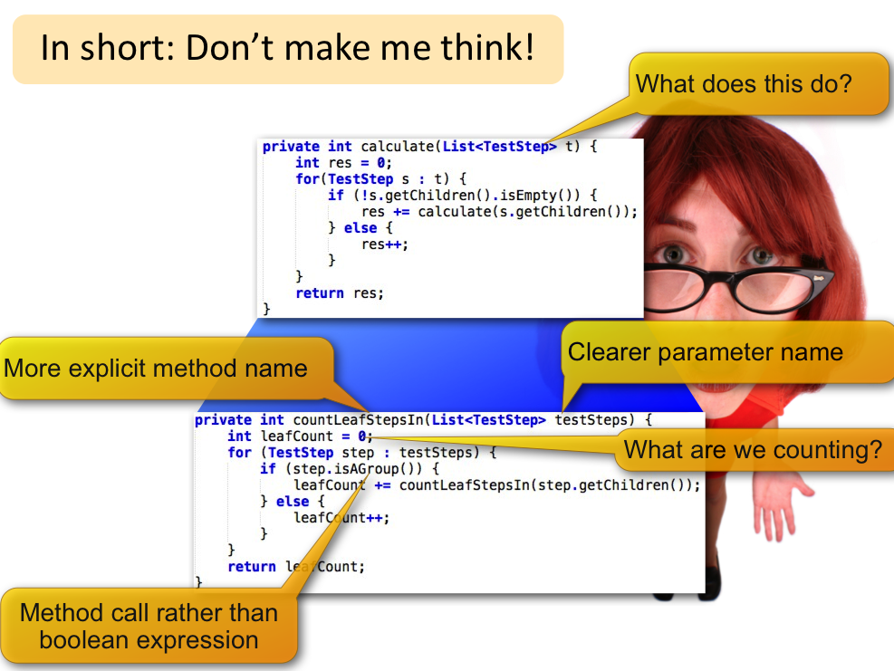
2.2 Clean Code‏

Slide 39
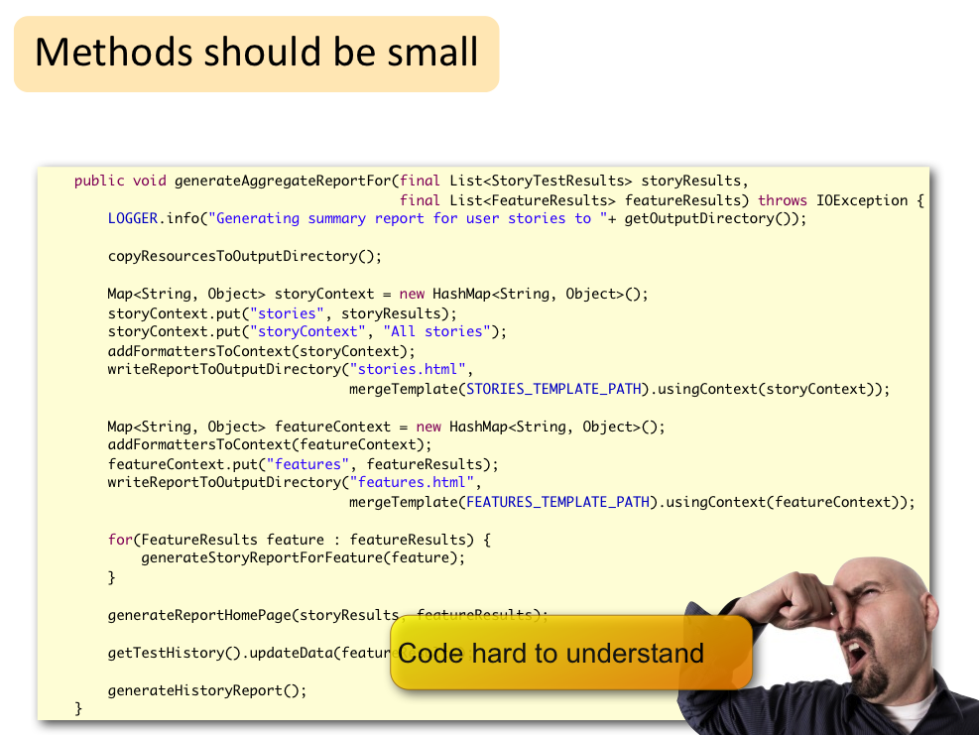
2.2 Clean Code‏

Slide 40
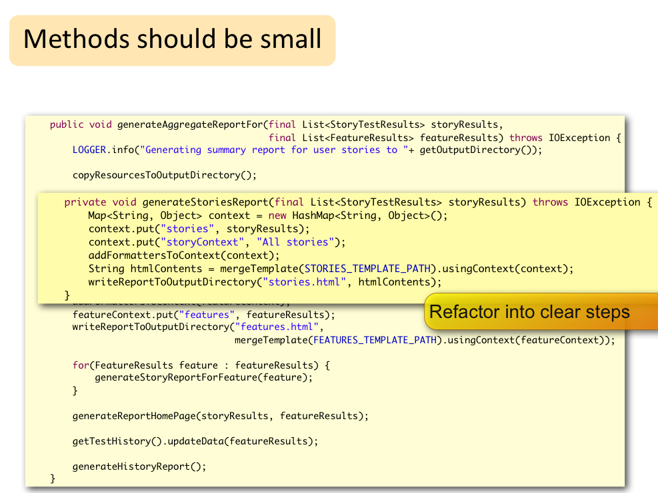
2.2 Clean Code‏

Slide 41
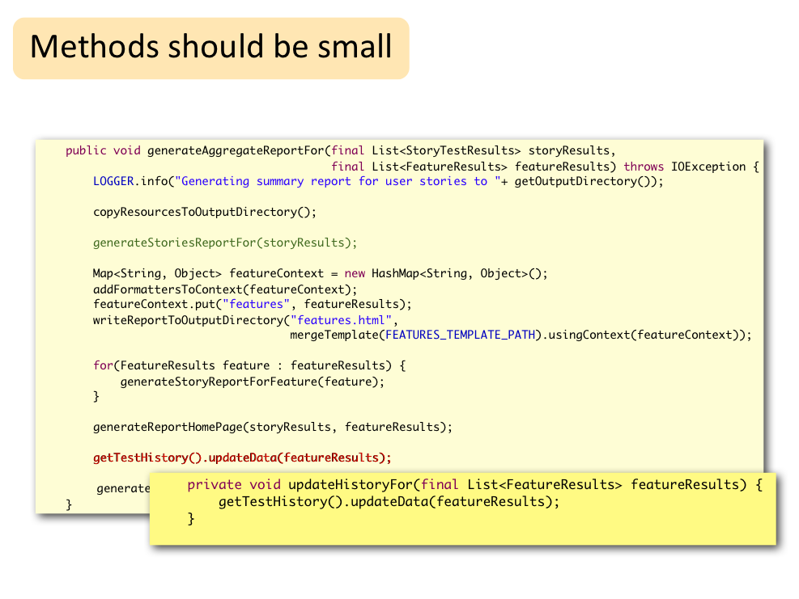
2.2 Clean Code‏

Slide 42
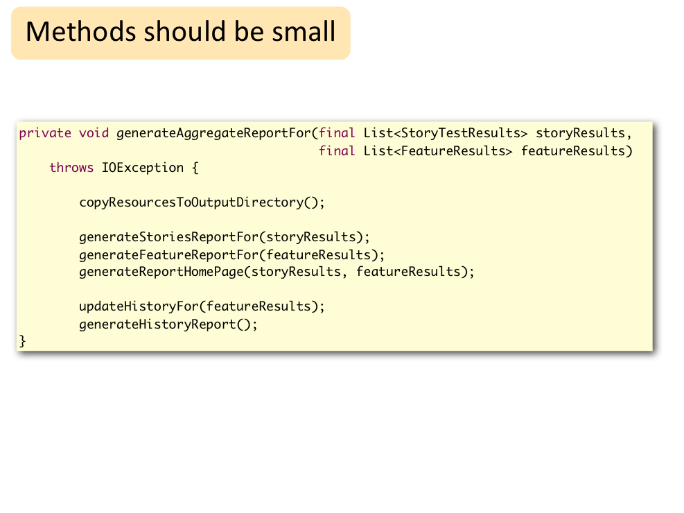
2.2 Clean Code‏

Slide 43
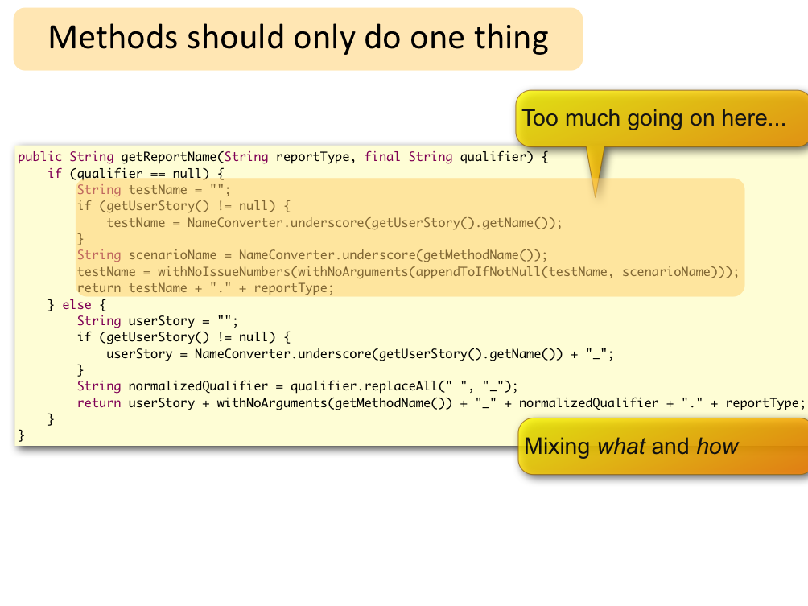
2.2 Clean Code‏

Slide 44
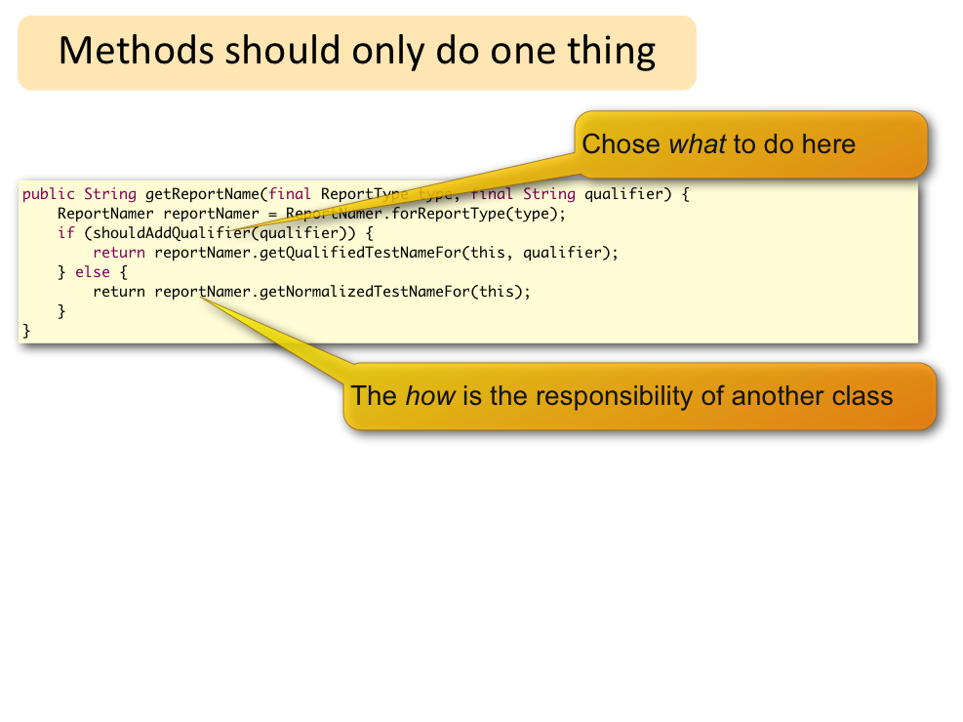
2.2 Clean Code‏

Slide 45
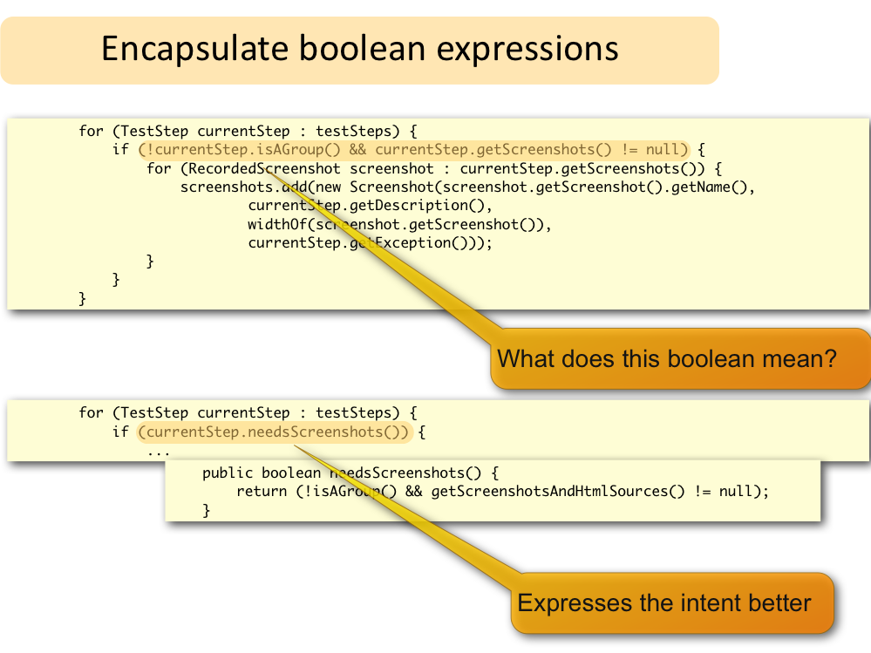
2.2 Clean Code‏

Slide 46
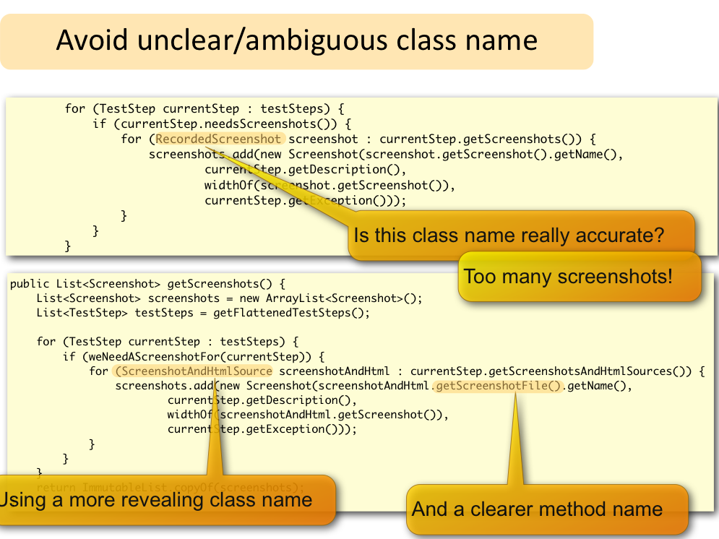
2.2 Clean Code‏

Slide 47
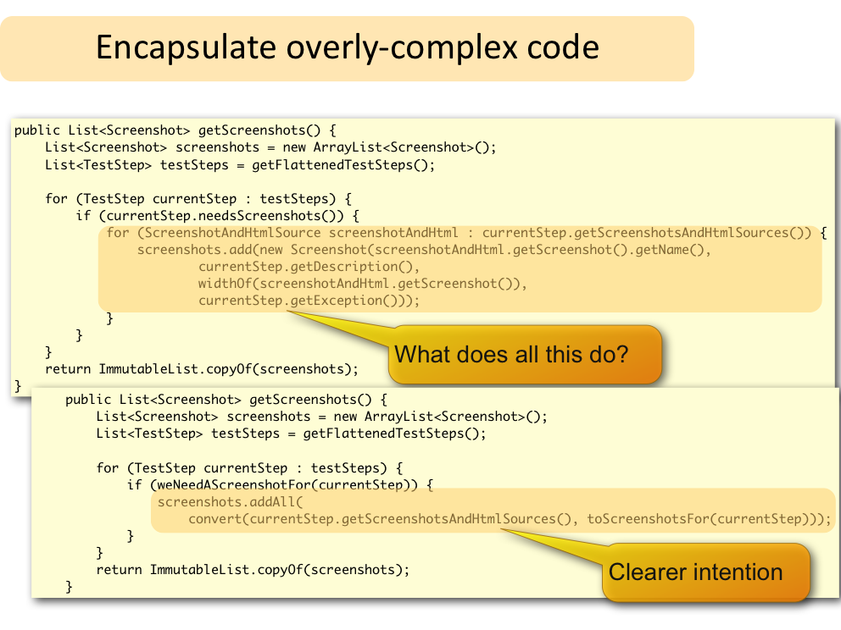
2.2 Clean Code‏

Slide 48
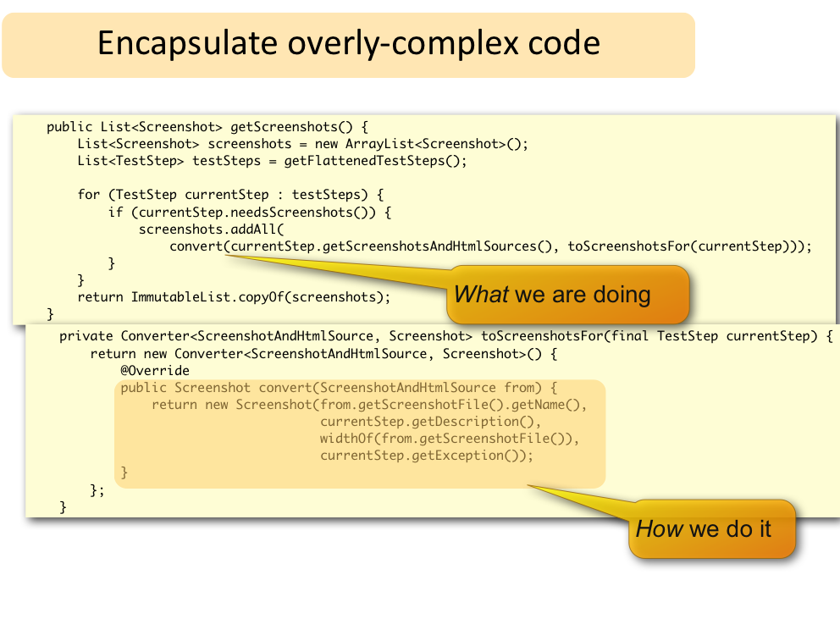
2.2 Clean Code‏

Slide 49
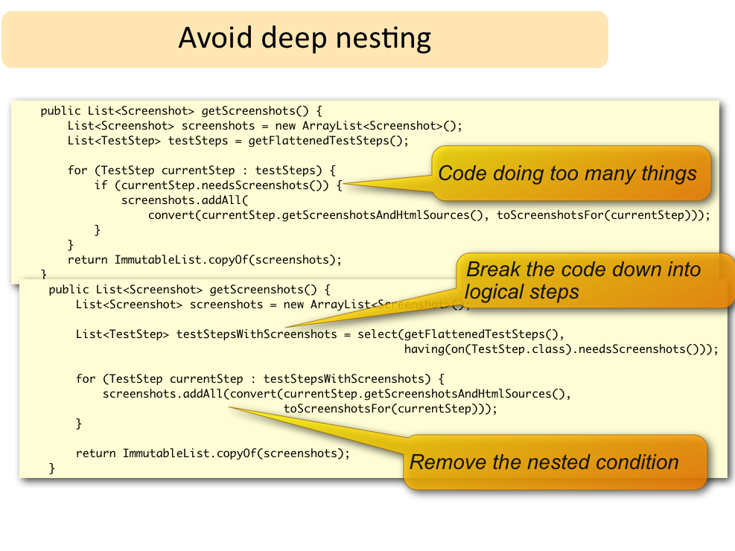
2.2 Clean Code‏

Slide 50
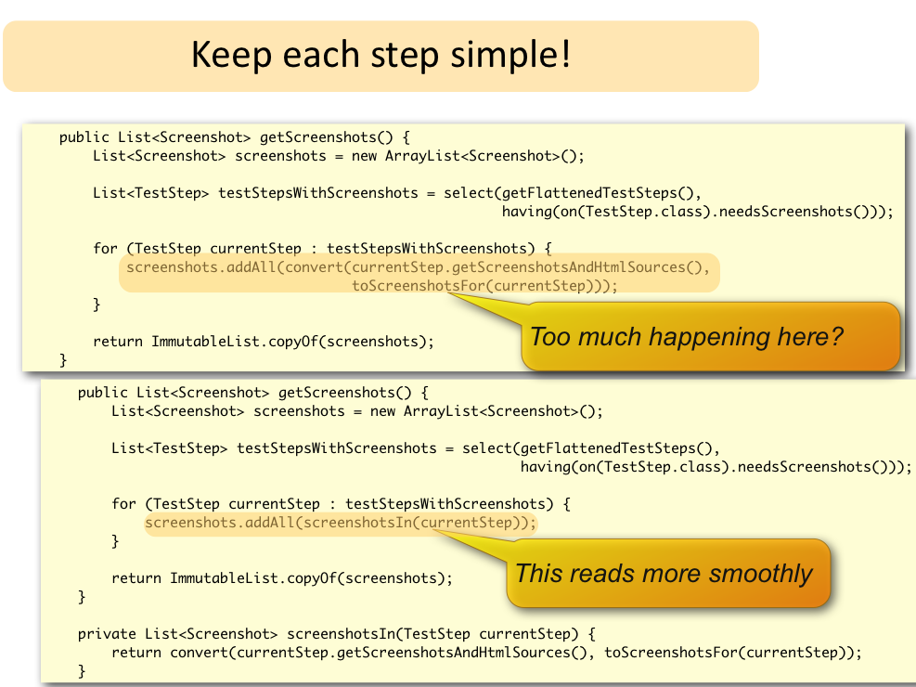
2.2 Clean Code‏

Slide 51
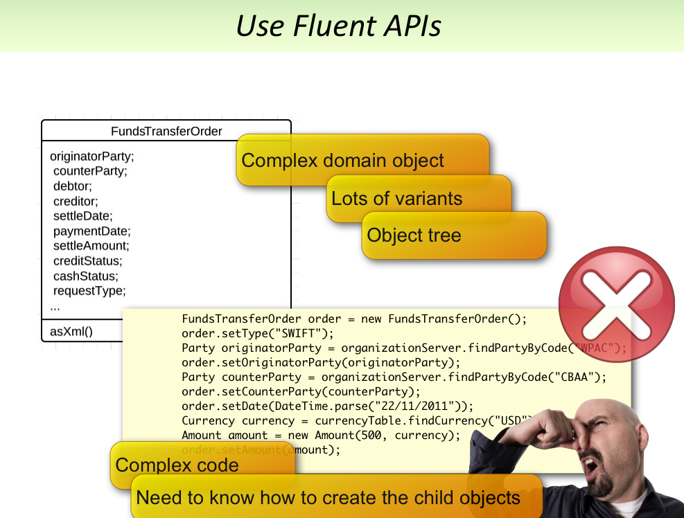
2.2 Clean Code‏

Slide 52
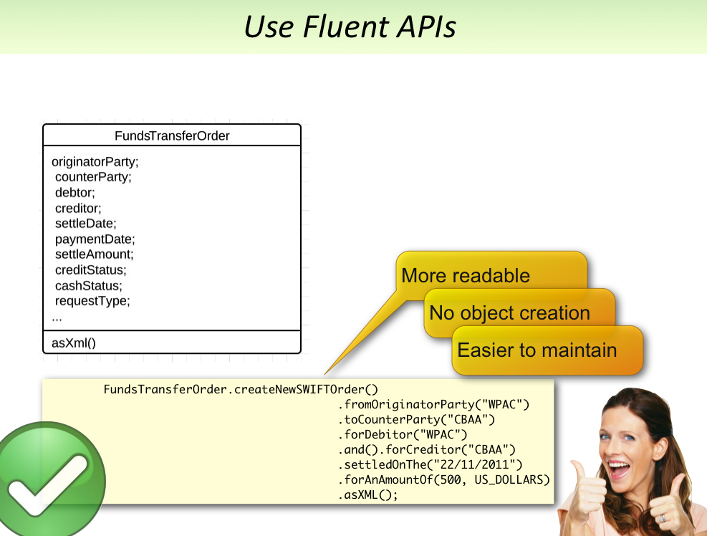
2.2 Clean Code‏

Slide 53
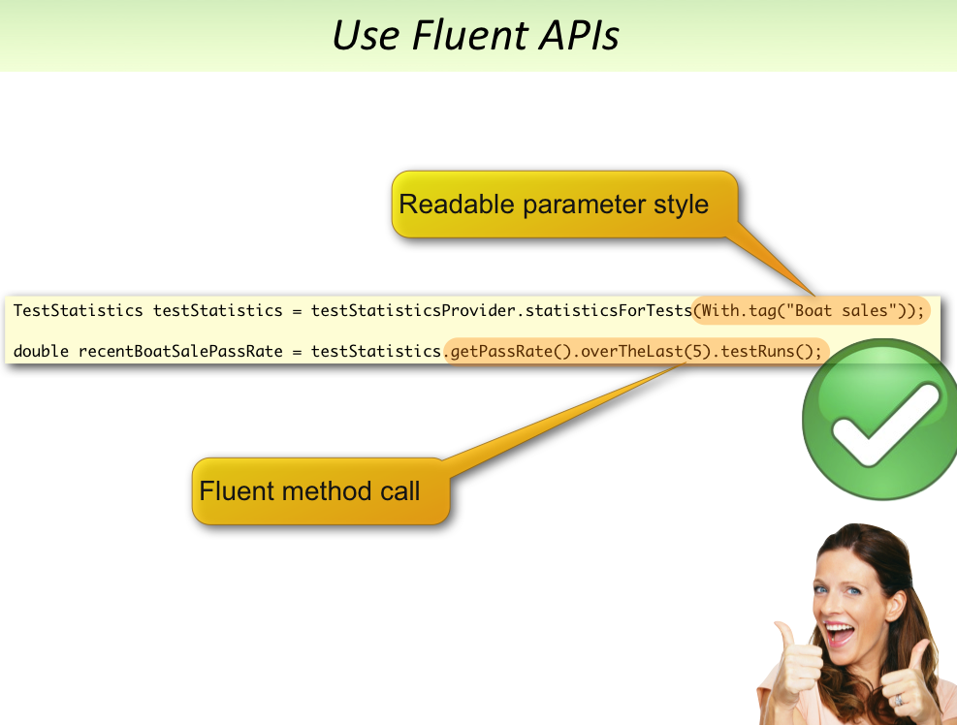
2.2 Clean Code‏

Slide 54
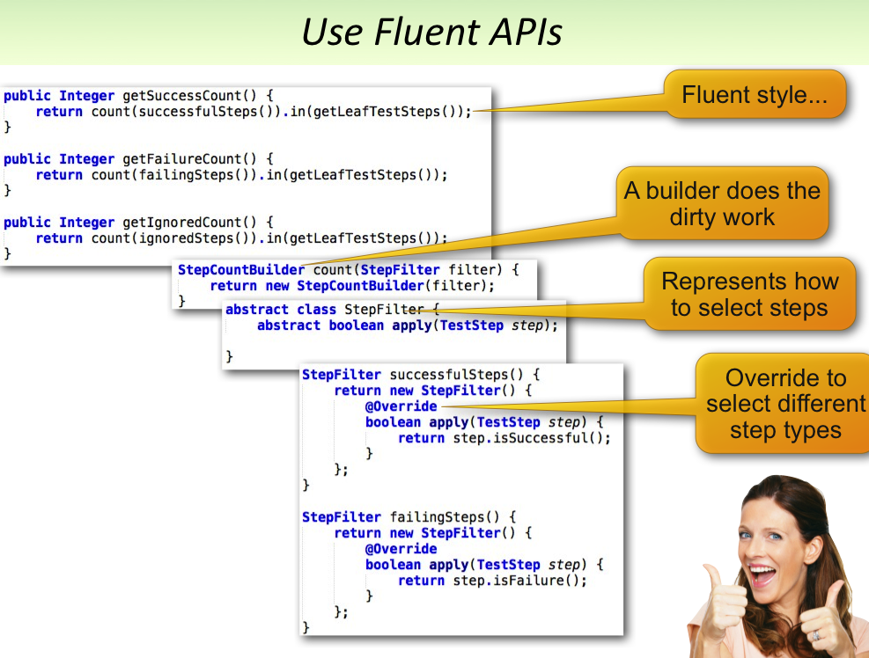
2.2 Clean Code‏

Slide 55
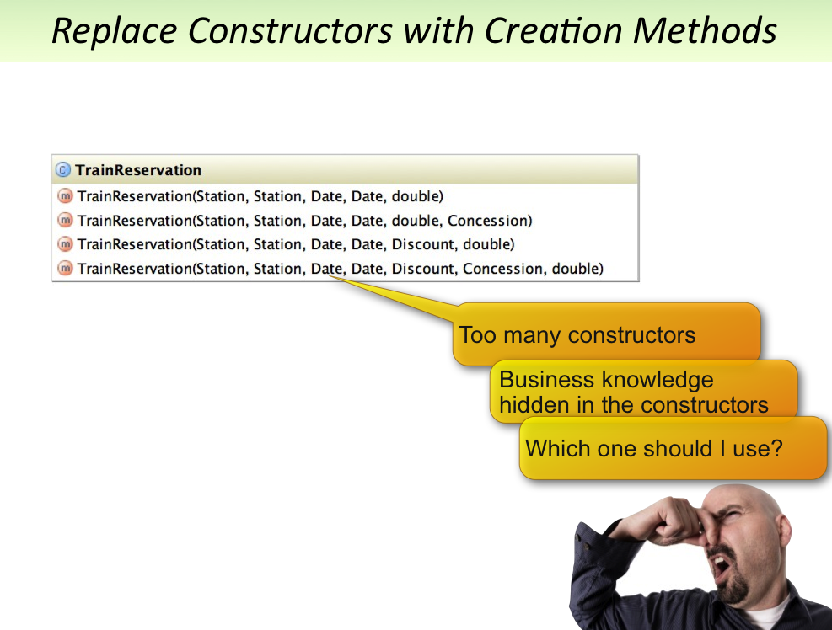
2.2 Clean Code‏

Slide 56
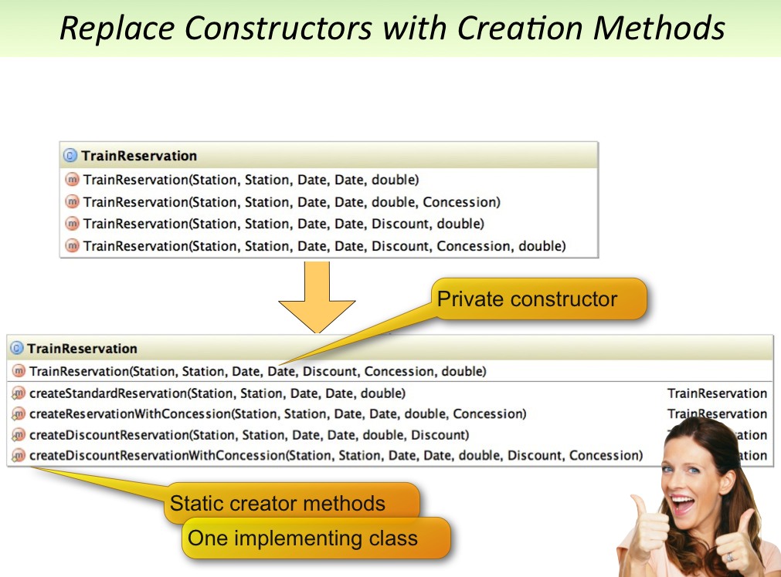
2.2 Clean Code‏

Slide 57
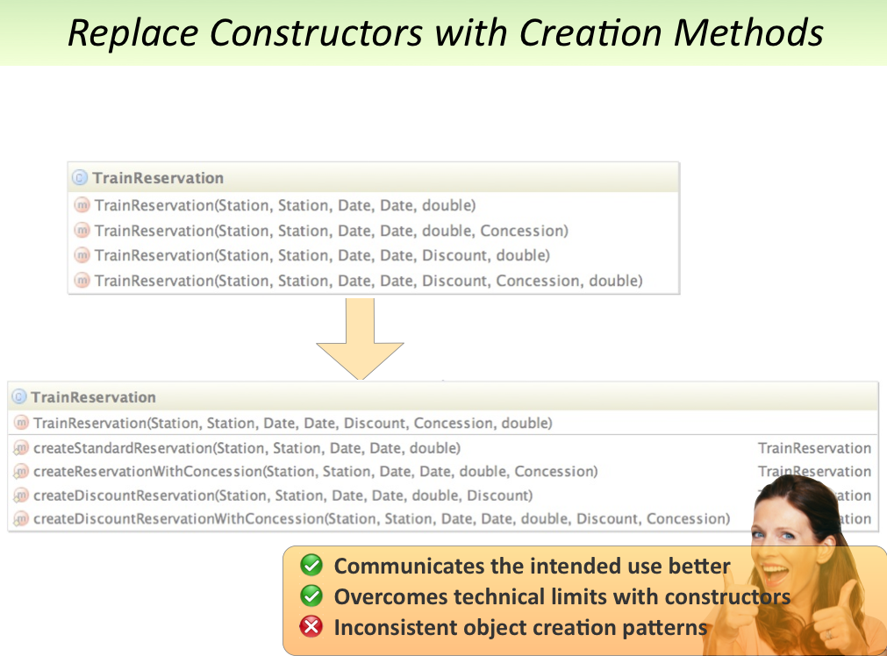
2.2 Clean Code‏

Slide 58
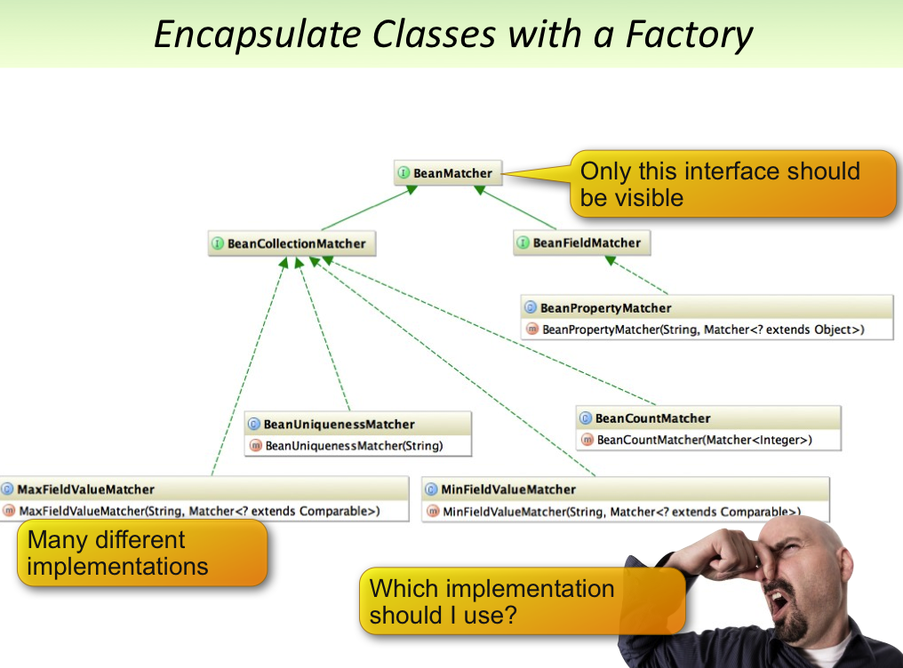
2.2 Clean Code‏

Slide 59
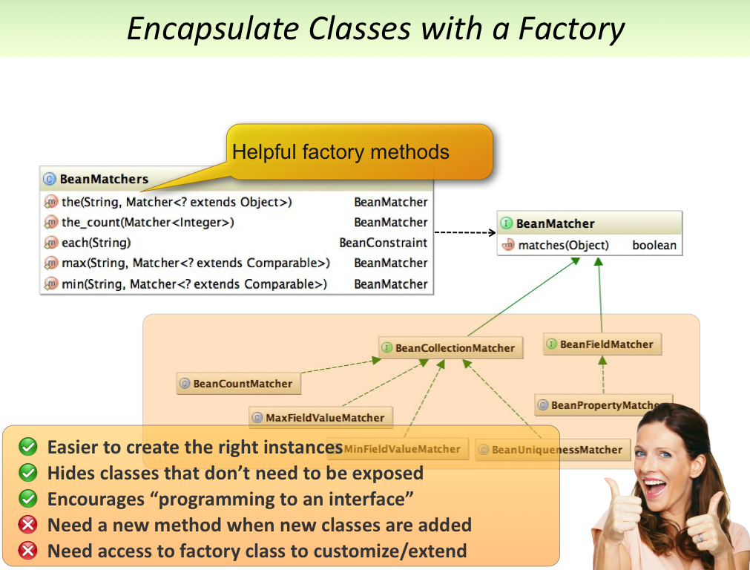
2.2 Clean Code‏

Slide 60
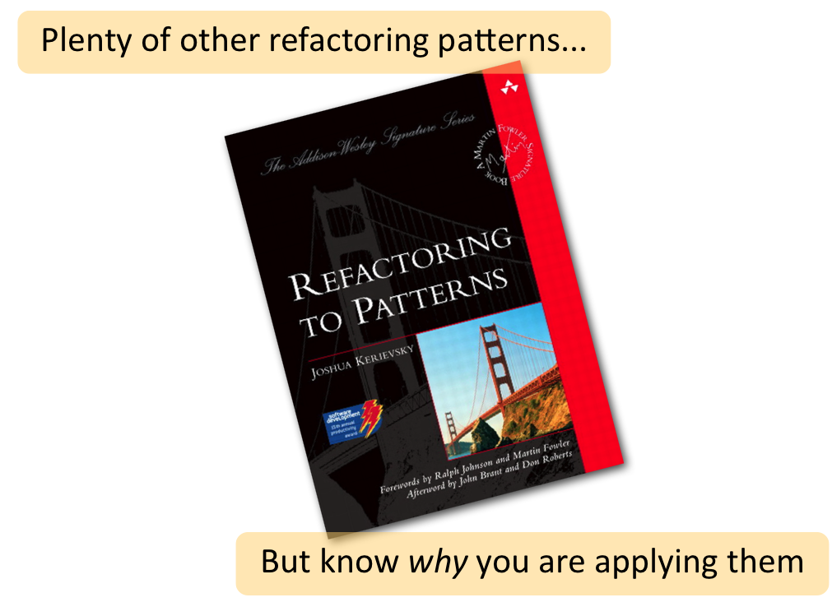
2.2 Clean Code‏

Slide 61
2.3 What is Refactoring?‏
A change made to the internal structure of software to make it easier
to understand and cheaper to modify without changing its observable behavior. — Refactoring, Martin Fowler, page 53.
Every refactoring is a behavior-preserving transformation since it transforms a design without altering the functionality provided by the code.
Refactoring typically involves
Removing duplicated or dead code
Simplifying complex code
Clarifying unclear code

Slide 62
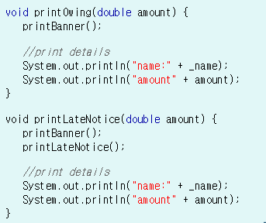
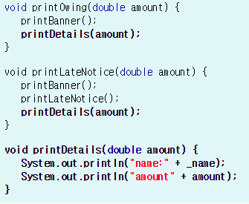
2.3 What is Refactoring?‏
Here is an example of Extract Method. This refactoring can be used when you have a code fragment that can be grouped together.
Extract Method turns the fragment into a method whose name is descriptive and explains its purpose.

Slide 63

2.4 Refactoring is revision‏
All good writing is based upon revision.
— Jacques Barzun, Simple & Direct, 4th Edition
Revision means to re-see or see again.
When we re-see variable or method names, algorithms, class
responsibilities, hierarchies or even technology choices, we make a
choice about whether to make an improvement.
Refactoring is the act of making small improvements that preserve
behavior while improving design.
Rewriting is the act of throwing out code and writing it from scratch.
Refactoring and rewriting are different activities, each of which may
result from re-vision.

Slide 64

2.5 How to Refactor‏
The secret to successful refactoring is to take baby steps.
Refactoring in small steps helps prevent the introduction of defects. You will be far more successful at refactoring if you learn to take it one step at a time.
Baby steps involve making a few code changes and then checking your work by running tests. Typical refactorings take seconds or minutes to perform.
Some large refactorings can require a sustained effort for days, weeks, or months until a transformation has been completed. We even implement large refactorings using a long sequence of baby steps.
Both experienced and inexperienced programmers would do well to learn to refactor in baby steps.

Slide 65
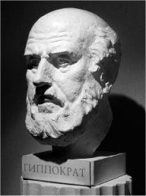
2.5 How to Refactor‏
The Hippocratic Oath
When refactoring, your ultimate goal is not to:
break anything
make things worse
introduce new behavior
The best way to do that is to tread cautiously,
taking very small, easily reversible steps.
First, Do No Harm. — Hippocrates

Slide 66
2.5 How to Refactor‏
Refactoring Safely
To refactor safely, you must either manually test that your changes didn't break anything or run automated tests.

Slide 67
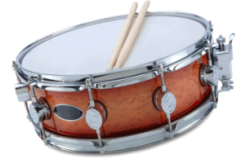
2.5 How to Refactor‏
The Rhythm of Refactoring goes like this:
Verify that all automated tests (microtests) pass
Decide what code to change
Implement one or more refactorings carefully
Run the microtests whenever you wish to confirm that changes have not altered system behavior
Repeat until the refactoring is complete or revert to an earlier state

Slide 68
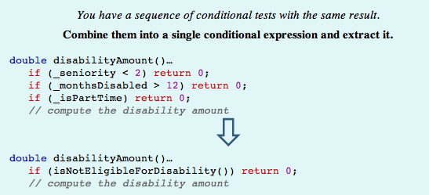
2.5 Consolidate Conditional Expression‏
Clarity
"Any fool can write code that a computer can understand.
Good programmers write code that humans can understand."
— Martin Fowler, Refactoring

Slide 69
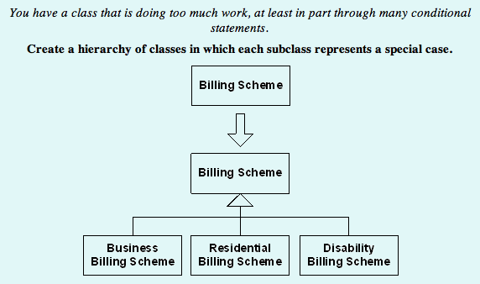
2.5 Extract Hierarchy‏
Highly Cohesive
Methods do only one thing and classes have a single, clear responsibility.

Slide 70
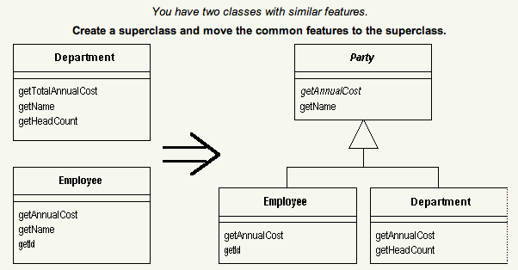
2.5 Extract Superclass‏
Duplication Free
A program should express each idea once and only once. Code may not
always appear to be identical and yet may be expressing the same logic
and information. Duplicate code may diverge to become out of sync

Slide 71
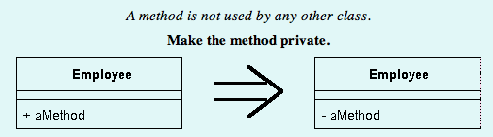
2.5 Hide Method‏
Encapsulated
A form of information hiding, code that is encapsulated
does not expose data or behavior that should be invisible

Slide 72
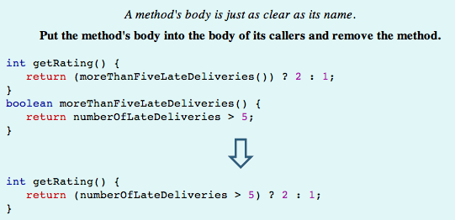
2.5 Inline Method‏
Simple
Code reflects the shortest path to a solution and incorporates
only enough complexity to handle its known responsibilities.
Simple code is easier to maintain and evolve.

Slide 73
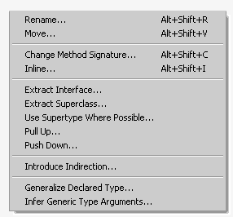
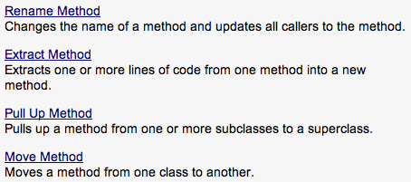
2.6 Automated Refactorings‏

Slide 74
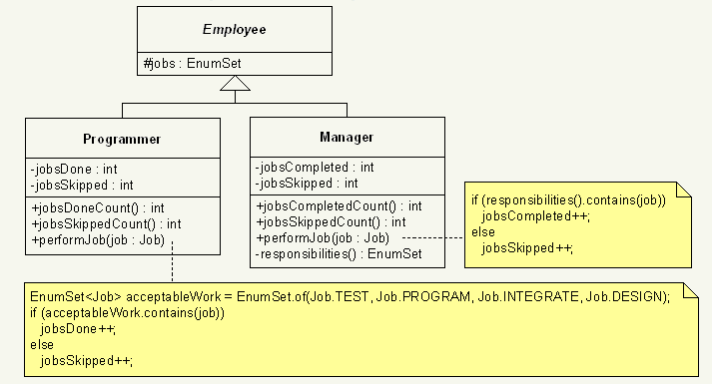
2.6 Remove Duplication - Before

Slide 75
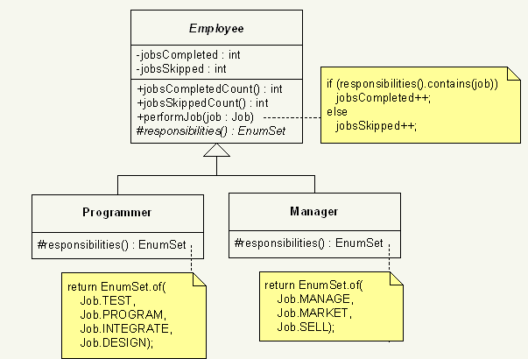
2.6 Remove Duplication - After

Slide 76
2.7 Refactoring Strategy: Piecemeal Refactoring‏
When faced with a large, unwieldy problem, the ancient Romans applied a "divide and conquer" strategy.
When faced with large, unwieldy refactoring problems, we do the same thing.
Piecemeal Refactoring encourages us to find small, behavior-preserving steps in the midst of what might seem like a large or involved refactoring.
You can often find piecemeal refactorings by looking for ways to conceptually break a problem in half or into smaller chunks before beginning your refactoring work.
Nearly all of the refactoring strategies and tactics you learn in this album embody the principle of piecemeal refactoring.

Slide 77
2.8 Refactoring Tactic: Caller Creates
When you need to create a new class or method that will be invoked by a caller, don't perform the creation where the new code will reside (e.g. in a new file or within the class that will contain the new method).
Instead, declare the to-be-created class/method where it will be used, i.e. in the caller code.
This will allow you to use IDE tools to automatically generate the exact code needed by the client, instead of retrofitting client code to the new class/method after creation.

Slide 78
2.8 Refactoring Tactic: Rejected Parameter‏
To avoid passing a parameter to code you want to extract, you must first reject the parameter from the extraction.
The video on the next page presents three different ways to reject a
parameter:
Inline the unwanted parameter.
Move the unwanted parameter out of the extraction block.
Turn the unwanted parameter into a field so it can be referenced from the extracted method instead of being passed as a parameter.

Slide 79
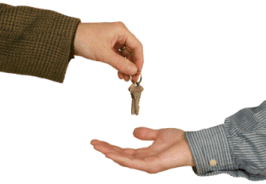
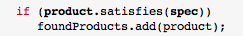
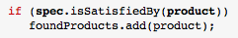
2.8 Refactoring Tactic: Caller Swap
Move responsibilities from a caller to a parameter
by calling the parameter with the original caller as its parameter.

Slide 80
2.8 Refactoring Tactic: Encapsulated Dependency
Before moving code to a new class, first encapsulate
dependencies, like fields.

Slide 81
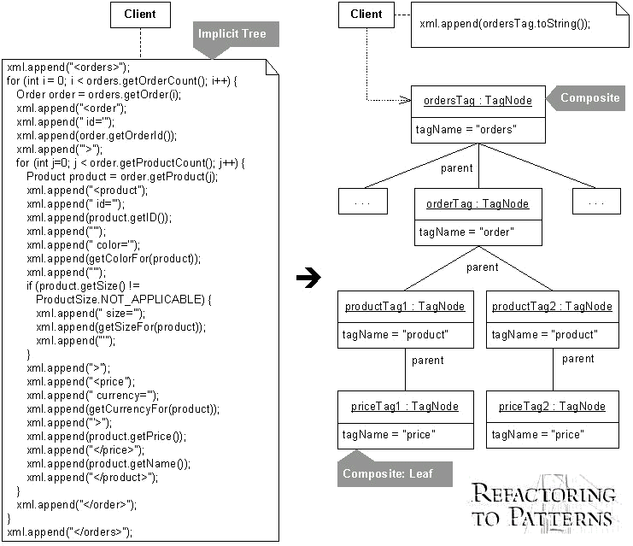
2.8 Refactoring Tactic: Example‏

Slide 82
2.8 Refactoring Tactic: Example‏

Slide 83
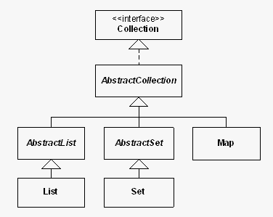
2.9 Sample

Slide 84
2.9 Sample – Removing unnecessary Interface and inheritance

Slide 85
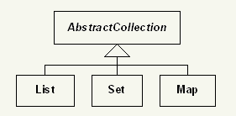
2.9 Sample - After

Slide 86
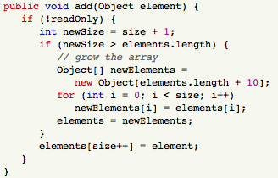
2.9 Sample - Removing A Long Method Smell‏

Slide 87

2.9 Sample - Removing A Long Method Smell (Composed Method)‏

Slide 88


2.9 Sample
A Map holds keys and values, whereas List and Set just
hold objects.

Slide 89
2.9 Sample – Duplicated Fields & Methods
Duplicated Fields & Methods in List and Set
AbstractCollection's method, addAll(...), contains
the smells Long Method, Duplicated Code , Switch Statement and Alternative Classes With Different Interfaces

Slide 90

2.9 Sample – Duplicated Fields & Methods

Slide 91
2.9 Sample – Don’t Fix Bugs
A List should allow duplicates, yet in
AbstractCollection your addAll(...) method is checking whether the element is already
contained before adding it.
There is a time and place to fix bugs and it is
not during refactoring.

Slide 92

2.10 Sample – Before

Slide 93
2.10 Sample – Before
1. Use automated refactorings as much as possible (rather than
manual changes to the code).
2. Remove the smell, Duplicated Code, from List and Set by first going after the "lowest hanging fruit" (i.e. the blatant duplication ), followed by the subtle duplication.
3. Remove the smells from AbstractCollection's addAll(...) method. When you are done, the code should not distinguish between a Set or a List and it should call a common get(...) method.
4. Make sure List and Set still subclass AbstractCollection.

Slide 94
2.10 Sample – Before
1. Use automated refactorings as much as possible (rather than
manual changes to the code).
2. Remove the smell, Duplicated Code, from List and Set by first going after the "lowest hanging fruit" (i.e. the blatant duplication ), followed by the subtle duplication.
3. Remove the smells from AbstractCollection's addAll(...) method. When you are done, the code should not distinguish between a Set or a List and it should call a common get(...) method.
4. Make sure List and Set still subclass AbstractCollection.

Slide 95

2.10 Sample – Primitive Obsession In Map
Map suffers from the Primitive Obsession smell
because it wastes too much code manipulating
the keys and values arrays.

Slide 96
2.10 Sample – Primitive Obsession In Map
Map suffers from the Primitive Obsession smell
because it wastes too much code manipulating
the keys and values arrays.

Slide 97

2.10 Sample – A Temporary Field In Map
Map has a field called indexWhereKeyFound that is a prime example of the Temporary Field Smell.

Slide 98

2.10 Sample – A Temporary Field In Map (Scaffolding)
Builders make changes to
buildings by first putting up
scaffolding to make their workeasier and safer.
Extract Method refactoring to produce:
getValueAt(...)
setValueAt(...)
When you no longer need your scaffolding, you can remove it by
applying the Inline Method refactoring.

Slide 99
2.10 Sample – A Temporary Field In Map (Scaffolding) - Before
1. Use automated refactorings as much as possible (rather than manual changes to the code).
2. Introduce (and remove at the end) the scaffolding methods getValueAt(...) and setValueAt(...).
3. Remove the Primitive Obsession smell from Map by changing keys and values into instances of the Smellections List class.
4. Remove the Temporary Field smell from Map by removing the indexWhereKeyFound field.
5. Refactor Map's add(...) and remove(...) methods so they rely on the fields, keys and values, which already know how to grow or shrink themselves.
NOTE: You will need to make the AbstractCollection method, removeElementAt(...), non-private so that Map's remove(...) method can call it.
6. Refactor Map's methods so that you remove all unneeded Map fields. Map should end up with only THREE fields (keys, values and readOnly).

Slide 100
3. Test Code smells & Refactoring

Slide 101


Terminology
3.0
Test vs SUT vs DOC:
Unit vs Component vs Customer Testing
Black Box vs White Box
Black box: know what it should do
White box: know how it is built inside

Slide 102
What Doest it Take To be Successful?
3.0
Programming Experience
+ xUnit Experience
+ Testing experience
-------------------------------
Robust Automated Tests

Slide 103
Why We Write Tests
3.0
Self-Testing Code helps us:
Produce better quality software
Produce the right software
Work faster
Respond to change (agility)
It does this by:
Providing focus
Providing rapid feedback
Reducing stress levels (anxiety)

Slide 104
Coding Objectives Comparison
3.0
 | Production | Testware
Correctness | Important | Crucial
Maintainability | Important | Crucial
Execution Speed | Crucial | Somewhat
Reusability | Important | Somewhat
Flexibility | Important | Not
Simplicity | Important? | Crucial
Ease of writing | Important? | Crucial
Crucial > Important > Important? >Somewhat > Not

Slide 105
A Sobering Thought
3.0
Expect to have just as much
test code as production
code!
The Challenge: How To
Prevent Doubling Cost of
Software Maintenance?

Slide 106
Why are They so Crucial?
3.0
Tests need to be maintained along with rest of the software.
Testware must be much easier to maintain than the software, otherwise:
It will slow you down
It will get left behind
Value drops to zero
You’ll go back to manual testing
Critical Success Factor:
Writing tests in a maintainable style

Slide 107

Economics of Maintainability - I
3.0
Test Automation is a lot easier to sell on
Cost reduction than
Software Quality Improvement or
Quality of Life Improvement

Slide 108

Economics of Maintainability - II
3.0
Test Automation is a lot easier to sell on
Cost reduction than
Software Quality Improvement or
Quality of Life Improvement

Slide 109
Goals of Automated Developer Tests
3.0
Before code is written
Tests as Specification
After code is written
Tests as Documentation
Tests as Safety Net (Bug Repellent)
Defect Localization (Minimize Debugging)
Minimize Cost of Running Tests
Fully Automated Tests
Repeatable Tests
Robust Tests

Slide 110
A Recipe for Success
3.0
Write some tests
start with the easy ones!
Note the Test Smells that show up
Refactor to remove obvious Test Smells
Apply appropriate xUnit Test Patterns
Write some more tests
possibly more complex
Repeat from Step 2 until:
All necessary tests written
No smells remain

Slide 111
What’s a “Test Smell”? - I
3.1
A set of symptoms of an underlying problem in test code
Smells must pass the “Sniff Test”
A smell should be obvious
It should “grab you by the nose”
Not necessarily the actual cause
There may be many possible causes for the symptom
Some root causes may contribute to several different smells
Note: Past literature often labels the cause as a smell.
e.g. “Sensitive Equality” is really a cause of “Fragile Test”

Slide 112

What’s a “Test Smell”? - II
3.1
Three common kinds of Test Smells:
Code Smells: Visible Problems in Test Code
Behavior Smells: Tests Behaving Badly
Project Smells: Testing-related problems visible to a Project Manager
Code Smells may be root cause of Behavior and Project Smells

Slide 113
What’s a “Pattern”?
3.2
A “pattern” is a “recurring solution to a recurring problem”
E.g. A “Decorator” object lets us add behavior to a system dynamically by adding one or more decorators to an existing object.
Must have been “invented” by three independent sources (The rule of 3 is sometimes used as a criterion: don't claim that something is a pattern unless you know of three independent usages. )
That’s what makes it a “pattern” as in: “I see a pattern here!”
The pattern exists whether or not is has been written up in the “pattern form”
Includes info on when (not) to use it

Slide 114
What’s a “Test Pattern”?
3.3
A “test pattern” is a recurring solution to a test automation problem
E.g. A “Mock Object” solves the problem of verifying the behavior of an object that should delegate behavior to other objects
Test Patterns occur at many levels:
Test Automation Strategy Patterns
Recorded Test vs Scripted Test
Test Design Patterns
Implicit SetUp vs Delegated SetUp
Test Coding Patterns
Assertion Method, Creation Method
Language-specific Test Coding Idioms
Expected Exception Test, Constructor Test

Slide 115
What’s a Code Smell?
3.4
A problem visible when looking at test code:
Tests are hard to understand
Tests contain coding errors that may result in
Missed bugs
Erratic Tests
Tests are difficult or impossible to write
No test API on SUT (System Under Test)
Cannot control initial state of SUT
Cannot observe final state of SUT
Sniff Test:
Problem must be visible (in their face) to test automater or test reader

Slide 116
Common Code Smells
3.5
Conditional Test Logic
Hard to Test Code
Obscure Test
Test Code Duplication
Test Logic in Production

Slide 117

Example
3.6
Test addItemQuantity and removeLineItem methods of Invoice

Slide 118
Example
3.6
The Whole Test
public void testAddItemQuantity_severalQuantity() throws Exception {
try {
// Setup Fixture
final int QUANTITY = 5;
Address billingAddress = new Address("1222 1st St SW", "Calgary", "Alberta", "T2N 2V2", "Canada");
Address shippingAddress = new Address("1333 1st St SW", "Calgary", "Alberta", "T2N 2V2", "Canada");
Customer customer = new Customer(99, "John", "Doe", new BigDecimal("30"), billingAddress,
shippingAddress);
Product product = new Product(88, "SomeWidget", new BigDecimal("19.99"));
Invoice invoice = new Invoice(customer);
// Exercise SUT
invoice.addItemQuantity(product, QUANTITY);
// Verify Outcome
List lineItems = invoice.getLineItems();
if (lineItems.size() == 1) {
LineItem actualLineItem = (LineItem)lineItems.get(0);
assertEquals(invoice, actualLineItem.getInvoice());
assertEquals(product, actualLineItem.getProduct());
assertEquals(quantity, actualLineItem.getQuantity());
assertEquals(new BigDecimal("30"), actualLineItem.getPercentDiscount());
assertEquals(new BigDecimal("19.99"), actualLineItem.getUnitPrice());
assertEquals(new BigDecimal(“69.96"), actualLineItem.getExtendedPrice());
} else {
assertTrue(“Invoice should have exactly one line item“, false);
}
} finally {
deleteObject(expectedLineItem);
deleteObject(invoice);
deleteObject(product);
deleteObject(customer);
deleteObject(billingAddress);
deleteObject(shippingAddress);
}

Slide 119
Example
3.6
Verifying the Outcome
// Verify Outcome
List lineItems = invoice.getLineItems();
if (lineItems.size() == 1) {
LineItem actualLineItem = (LineItem)lineItems.get(0);
assertEquals(invoice, actualLineItem.getInvoice());
assertEquals(product, actualLineItem.getProduct());
assertEquals(quantity, actualLineItem.getQuantity());
assertEquals(new BigDecimal("30"), actualLineItem.getPercentDiscount());
assertEquals(new BigDecimal("19.99"), actualLineItem.getUnitPrice());
assertEquals(new BigDecimal(“69.96"), actualLineItem.getExtendedPrice());
} else {
assertTrue(“Invoice should have exactly one line item“, false);
}
Obtuse Assertion

Slide 120
Example
3.6
Use Better Assertion
// Verify Outcome
List lineItems = invoice.getLineItems();
if (lineItems.size() == 1) {
LineItem actualLineItem = (LineItem)lineItems.get(0);
assertEquals(invoice, actualLineItem.getInvoice());
assertEquals(product, actualLineItem.getProduct());
assertEquals(quantity, actualLineItem.getQuantity());
assertEquals(new BigDecimal("30"), actualLineItem.getPercentDiscount());
assertEquals(new BigDecimal("19.99"), actualLineItem.getUnitPrice());
assertEquals(new BigDecimal(“69.96"), actualLineItem.getExtendedPrice());
} else {
fail(“Invoice should have exactly one line item“);
}

Slide 121
Example
3.6
Use Better Assertion
// Verify Outcome
List lineItems = invoice.getLineItems();
if (lineItems.size() == 1) {
LineItem actualLineItem = (LineItem)lineItems.get(0);
assertEquals(invoice, actualLineItem.getInvoice());
assertEquals(product, actualLineItem.getProduct());
assertEquals(quantity, actualLineItem.getQuantity());
assertEquals(new BigDecimal("30"), actualLineItem.getPercentDiscount());
assertEquals(new BigDecimal("19.99"), actualLineItem.getUnitPrice());
assertEquals(new BigDecimal(“69.96"), actualLineItem.getExtendedPrice());
} else {
fail(“Invoice should have exactly one line item“);
}
Hard-Wired
Test Data
Fragile Tests

Slide 122
Example (Pattern)
3.6
Expected Object
List lineItems = invoice.getLineItems();
if (lineItems.size() == 1) {
LineItem actualLineItem = (LineItem)lineItems.get(0);
LineItem expectedLineItem = new LineItem(invoice, product, QUANTITY);
assertEquals(expectedLineItem.getInvoice(), actualLineItem.getInvoice());
assertEquals(expectedLineItem.getProduct(), actualLineItem.getProduct());
assertEquals(expectedLineItem.getQuantity(), actualLineItem.getQuantity());
assertEquals(expectedLineItem.getPercentDiscount(),
actualLineItem.getPercentDiscount());
assertEquals(expectedLineItem.getUnitPrice(),
actualLineItem.getUnitPrice());
assertEquals(expectedLineItem.getExtendedPrice(),
actualLineItem.getExtendedPrice());
} else {
fail("invoice should have exactly one line item");
}

Slide 123
Example
3.6
Verbose Test
List lineItems = invoice.getLineItems();
if (lineItems.size() == 1) {
LineItem actualLineItem = (LineItem)lineItems.get(0);
LineItem expectedLineItem = new LineItem(invoice, product, QUANTITY);
assertEquals(expectedLineItem.getInvoice(), actualLineItem.getInvoice());
assertEquals(expectedLineItem.getProduct(), actualLineItem.getProduct());
assertEquals(expectedLineItem.getQuantity(), actualLineItem.getQuantity());
assertEquals(expectedLineItem.getPercentDiscount(),
actualLineItem.getPercentDiscount());
assertEquals(expectedLineItem.getUnitPrice(),
actualLineItem.getUnitPrice());
assertEquals(expectedLineItem.getExtendedPrice(),
actualLineItem.getExtendedPrice());
} else {
fail("invoice should have exactly one line item");
}

Slide 124
Example
3.6
Introduce Custom Assert
List lineItems = invoice.getLineItems();
if (lineItems.size() == 1) {
LineItem actualLineItem = (LineItem)lineItems.get(0);
LineItem expectedLineItem = new LineItem(invoice, product, QUANTITY);
assertLineItemsEquals(expectedLineItem , actualLineItem );
} else {
fail("invoice should have exactly one line item");
}

Slide 125
Example
3.6
Conditional Test Logic
List lineItems = invoice.getLineItems();
if (lineItems.size() == 1) {
LineItem actualLineItem = (LineItem)lineItems.get(0);
LineItem expectedLineItem = new LineItem(invoice, product, QUANTITY);
assertLineItemsEquals(expectedLineItem , actualLineItem );
} else {
fail("invoice should have exactly one line item");
}

Slide 126
Example
3.6
Replace Conditional Logic with Guard Assertion
List lineItems = invoice.getLineItems();
assertEquals(“number of items”, lineItems.size(), 1);
LineItem actualLineItem = (LineItem)lineItems.get(0);
LineItem expectedLineItem = new LineItem(invoice, product, QUANTITY);
assertLineItemsEquals(expectedLineItem , actualLineItem );

Slide 127
The Smells Seen Thus Far - I
3.7
Obscure Test
Test is hard to understand.
Common Causes:
Verbose Test
So much test code that it obscures the test intent
Eager Test
Several tests merged into one Test Method
General Fixture
Fixture contains objects irrelevant for this test
Obtuse Assertion
Using the wrong kind of assertion
Hard-Coded Test Data
Lots of “Magic Numbers” or Strings used when creating objects.
More likely to result in unrepeatable tests

Slide 128
The Smells Seen Thus Far - II
3.7
Other Obscure Test Causes:
Indirect Testing
Interacting with the SUT via other software
A cause of Fragile Tests (Behavior Smell)
Mystery Guest
Lots of “Magic Numbers” or Strings used as keys to database.
“Lopsided” feel to tests (either Setup or Verification of outcome is external to test)

Slide 129
The Smells Seen Thus Far - III
3.7
Conditional Test Logic
Tests containing conditional logic (IF statements or loops)
Hard to verify correctness. Does it always test the same thing?
A cause of Buggy Tests (Project Smell)
Test Code Duplication
Same code sequences appear many times in many tests
More code to modify when something changes
A cause of Fragile Tests (Behavior Smell)

Slide 130
The Patterns Used So Far
3.8
Expected Objects
Use AssertEquals on whole objects rather than comparing individual fields
Guard Assertions
Remove conditional logic associated with avoiding assertions when they would fail
Custom Asserts
Remove Test Code Duplication by factoring out common code
Remove conditional logic associated with complex verification logic

Slide 131
Patterns
3.9
Expected Object
Replace a series of assertEquals on individual fields:
assertEquals (expectedXvalue, actualPoint .getx() );
assertEquals ( expectedYvalue, actualPoint .getY() );
with a single assertion of the whole object:
assertEquals (expectedPoint, actualPoint );
Ways to construct the Expected Object:
Point expectedPoint = new Point(17.0, 9.0)
Or:
expectedPoint.setX( 17.0);
expectedPoint.sety( 9.0);

Slide 132
Patterns
3.9
Guard Assertion
Conditional Test Logic creates multiple execution paths thruogh test:
if (actualCollection == null)
fail(“collection is null”);
else {
assertTrue( actualCollection.includes(expectedElement) );
}
This makes tests hard to verify. Better to replace with a Guard Assertion:
assertNotNull( “collection is null”, actualCollection);
assertTrue( actualCollection.includes(expectedElement));

Slide 133
Patterns
3.9
Custom Assertion
Remove duplicated assertion logic by creating your own Assertion Methods to:
Improve readability
Intent-revealing methods that verify expected outcome
Simplify troubleshooting
Make xUnit failure reports easier to understand
Define test-specific equality
Ignore “don’t care” fields when comparing objects
“Foreign Method” specific to testing
Can be defined using Extract Method Refactoring.

Slide 134
Exercise
3.10
CS1 – Result Verification
Situation:
You have just inherited maintenance of the Flight Management System. The good news is that there are automated unit tests. The bad news is that most of the tests look something like these tests.
Instructions:
Examine the code in the handout and determine what code smells you are seeing.
Discussion Questions:
Which Code Smells are we having?
What are the underlying root causes?
Which XUnit Patterns can we apply to alleviate them?

Slide 135
Example
3.11
The Whole Test
public void testAddItemQuantity_severalQuantity() throws Exception {
try {
// Setup Fixture
final int QUANTITY = 5;
Address billingAddress = new Address("1222 1st St SW", "Calgary", "Alberta", "T2N 2V2", "Canada");
Address shippingAddress = new Address("1333 1st St SW", "Calgary", "Alberta", "T2N 2V2", "Canada");
Customer customer = new Customer(99, "John", "Doe", new BigDecimal("30"), billingAddress,
shippingAddress);
Product product = new Product(88, "SomeWidget", new BigDecimal("19.99"));
Invoice invoice = new Invoice(customer);
// Exercise SUT
invoice.addItemQuantity(product, QUANTITY);
// Verify Outcome
List lineItems = invoice.getLineItems();
List lineItems = invoice.getLineItems();
assertEquals(“number of items”, lineItems.size(), 1);
LineItem actualLineItem = (LineItem)lineItems.get(0);
LineItem expectedLineItem = new LineItem(invoice, product, QUANTITY);
assertLineItemsEquals(expectedLineItem , actualLineItem );
} finally {
deleteObject(expectedLineItem);
deleteObject(invoice);
deleteObject(product);
deleteObject(customer);
deleteObject(billingAddress);
deleteObject(shippingAddress);
}

Slide 136
Example
3.11
Inline Fixture Teardown - Naive
try {
// Setup Fixture
// Exercise SUT
// Verify Outcome
} finally {
deleteObject(expectedLineItem);
deleteObject(invoice);
deleteObject(product);
deleteObject(customer);
deleteObject(billingAddress);
deleteObject(shippingAddress);
}

Slide 137
Example
3.11
Inline Fixture Teardown - Robust
try {
// Setup Fixture
// Exercise SUT
// Verify Outcome
} finally {
try {
deleteObject(expectedLineItem);
} finally {
try {
deleteObject(invoice);
} finally {
try {
deleteObject(product);
} finally {
}

Slide 138
Pattern
3.12
Implicit Fixture Teardown - Naive
public void testAddItemQuantity_severalQuantity ()
throws Exception {
// Setup Fixture
// Exercise SUT
// Verify Outcome
}
public void tearDown() {
deleteObject(expectedLineItem);
deleteObject(invoice);
deleteObject(product);
deleteObject(customer);
deleteObject(billingAddress);
deleteObject(shippingAddress);
}

Slide 139
Pattern
3.12
Implicit Fixture Teardown - Robust
public void testAddItemQuantity_severalQuantity ()
throws Exception {
// Setup Fixture
// Exercise SUT
// Verify Outcome
}
public void tearDown() {
try {
deleteObject(expectedLineItem);
} finally {
try {
deleteObject(invoice);
} finally {
try {
deleteObject(product);
} finally {
:

Slide 140
Pattern
3.12
Automated Fixture Teardown - I
public void testAddItemQuantity_severalQuantity () {
final int QUANTITY = 5;
Address billingAddress = new Address("1222 1st St SW",
"Calgary", "Alberta", "T2N 2V2", "Canada");
addTestObject( billingAddress );
Address shippingAddress = new Address("1333 1st St SW",
"Calgary", "Alberta", "T2N 2V2", "Canada");
addTestObject(shippingAddress );
:
}
public void tearDown() {
deleteAllTestObjects();
}

Slide 141
Pattern
3.12
Automated Fixture Teardown - II
public void deleteAllTestObjects() {
Iterator i = testObjects.iterator();
while (i.hasNext()) {
try {
Deletable object = (Deletable) i.next();
object.delete();
} catch (Exception e) {
// do nothing if the remove failed
}
}
}

Slide 142
Pattern
3.12
Transaction Rollback Teardown
public void setUp() {
TransactionManager.beginTransaction();
}
public void tearDown() {
TransactionManager.abortTransaction();
}
Important: SUT must not commit transaction
DfT (Design for Testability) Pattern: Humble Transaction Controller

Slide 143
The Smells Seen Thus Far
3.13
Complex Undo Logic
Complex fixture teardown code
More likely to leave test environment corrupted leading to Erratic Tests (Causes: Unrepeatable Tests or Interacting Tests)

Slide 144
The Patterns Used So Far
3.14
Inline Teardown
Hand-coded tear down logic within the Test Method
Implicit Teardown
Hand-coded tear down logic in a tearDown method
Automated Teardown
Tear down all registered test objects programmatically
Transaction Rollback Teardown
Get the database to undo all the changes made by test
SUT must not commit transaction

Slide 145
Example
3.15
The Whole Test
public void testAddItemQuantity_severalQuantity () throws Exception {
// Setup Fixture
final int QUANTITY = 5;
Address billingAddress = new Address("1222 1st St SW", "Calgary",
"Alberta", "T2N 2V2", "Canada");
addTestObject(billingAddress);
Address shippingAddress = new Address("1333 1st St SW", "Calgary",
"Alberta", "T2N 2V2", "Canada");
addTestObject(billingAddress);
Customer customer = new Customer(99, "John", "Doe", new BigDecimal("30"),
billingAddress, shippingAddress);
addTestObject(billingAddress);
Product product = new Product(88, "SomeWidget", new BigDecimal("19.99"));
addTestObject(billingAddress);
Invoice invoice = new Invoice(customer);
addTestObject(billingAddress);
// Exercise SUT
invoice.addItemQuantity(product, QUANTITY);
// Verify Outcome
assertEquals("number of items",lineItems.size(),1);
LineItem actualLineItem = (LineItem)lineItems.get(0);
LineItem expectedLineItem = newLineItem(invoice, product, QUANTITY);
assertLineItemsEqual(expectedLineItem, actualLineItem);
}

Slide 146
Smell
3.16
Hard-Coded Test Data
public void testAddItemQuantity_severalQuantity () throws Exception {
// Setup Fixture
final int QUANTITY = 5;
Address billingAddress = new Address("1222 1st St SW", "Calgary",
"Alberta", "T2N 2V2", "Canada");
addTestObject(billingAddress);
Address shippingAddress = new Address("1333 1st St SW", "Calgary",
"Alberta", "T2N 2V2", "Canada");
addTestObject(billingAddress);
Customer customer = new Customer(99, "John", "Doe", new BigDecimal("30"),
billingAddress, shippingAddress);
addTestObject(billingAddress);
Product product = new Product(88, "SomeWidget", new BigDecimal("19.99"));
addTestObject(billingAddress);
Invoice invoice = new Invoice(customer);
addTestObject(billingAddress);
// Exercise SUT
invoice.addItemQuantity(product, QUANTITY);
}
Hard-coded
Test Data
(Obscure Test)
Unrepeatable
Tests

Slide 147
Pattern
3.17
Distinct Generated Values
public void testAddItemQuantity_severalQuantity () {
final int QUANTITY = 5 ;
Address billingAddress = new Address(getUniqueString(),
getUniqueString(), getUniqueString(),
getUniqueString(), getUniqueString());
Address shippingAddress = new Address(getUniqueString(),
getUniqueString(), getUniqueString(),
getUniqueString(), getUniqueString());
Customer customer = new Customer(
getUniqueInt(), getUniqueString(),
getUniqueString(), getUniqueDiscount(),
billingAddress, shippingAddress);
Product product = new Product(
getUniqueInt(), getUniqueString(),
getUniqueNumber());
Invoice invoice = new Invoice(customer);

Slide 148
Pattern
3.17
Creation Method
public void testAddItemQuantity_severalQuantity () {
final int QUANTITY = 5;
Address billingAddress = createAnonymousAddress();
Address shippingAddress = createAnonymousAddress();
Customer customer = createCustomer( billingAddress,
shippingAddress);
Product product = createAnonymousProduct();
Invoice invoice = new Invoice(customer);

Slide 149
Smell
3.18
Obscure Test - Irrelevant Information
public void testAddItemQuantity_severalQuantity () {
final int QUANTITY = 5;
Address billingAddress = createAnonymousAddress();
Address shippingAddress = createAnonymousAddress();
Customer customer = createCustomer( billingAddress,
shippingAddress);
Product product = createAnonymousProduct();
Invoice invoice = new Invoice(customer);
Irrelevant
Information
(Obscure Test)

Slide 150
Refactoring
3.19
Remove Irrelevant Information - I
public void testAddItemQuantity_severalQuantity () {
final int QUANTITY = 5 ;
Customer customer = createAnonymousCustomer();
Product product = createAnonymousProduct();
Invoice invoice = new Invoice(customer);
// Exercise
invoice.addItemQuantity(product, QUANTITY);
// Verify
LineItem expectedLineItem = newLineItem(invoice,
product, QUANTITY, product.getPrice()*QUANTITY );
List lineItems = invoice.getLineItems();
assertEquals("number of items", lineItems.size(), 1);
LineItem actualLineItem = (LineItem)lineItems.get(0);
assertLineItemsEqual(expectedLineItem, actualLineItem);
}
Irrelevant
Information
(Obscure Test)

Slide 151
Refactoring
3.19
Remove Irrelevant Information - II
public void testAddItemQuantity_severalQuantity () {
final int QUANTITY = 5 ;
Product product = createAnonymousProduct();
Invoice invoice = createAnonymousInvoice()
// Exercise
invoice.addItemQuantity(product, QUANTITY);
// Verify
LineItem expectedLineItem = newLineItem(invoice,
product, QUANTITY, product.getPrice()*QUANTITY );
List lineItems = invoice.getLineItems();
assertEquals("number of items", lineItems.size(), 1);
LineItem actualLineItem = (LineItem)lineItems.get(0);
assertLineItemsEqual(expectedLineItem, actualLineItem);
}

Slide 152
Refactoring
3.20
Introduce Custom Assertion - I
public void testAddItemQuantity_severalQuantity () {
final int QUANTITY = 5 ;
Product product = createAnonymousProduct();
Invoice invoice = createAnonymousInvoice()
// Exercise
invoice.addItemQuantity(product, QUANTITY);
// Verify
LineItem expectedLineItem = newLineItem(invoice,
product, QUANTITY, product.getPrice()*QUANTITY );
List lineItems = invoice.getLineItems();
assertEquals("number of items", lineItems.size(), 1);
LineItem actualLineItem = (LineItem)lineItems.get(0);
assertLineItemsEqual(expectedLineItem, actualLineItem);
}
Mechanics
Hides Intent

Slide 153
Refactoring
3.20
Introduce Custom Assertion - II
public void testAddItemQuantity_severalQuantity () {
final int QUANTITY = 5 ;
Product product = createAnonymousProduct();
Invoice invoice = createAnonymousInvoice()
// Exercise
invoice.addItemQuantity(product, QUANTITY);
// Verify
LineItem expectedLineItem = newLineItem(invoice,
product, QUANTITY, product.getPrice()*QUANTITY );
assertExactlyOneLineItem(invoice, expectedLineItem );
}

Slide 154
The Whole Test – Done
3.21
public void testAddItemQuantity_severalQuantity () {
final int QUANTITY = 5 ;
Product product = createAnonymousProduct();
Invoice invoice = createAnonymousInvoice();
// Exercise
invoice.addItemQuantity(product, QUANTITY);
// Verify
LineItem expectedLineItem = newLineItem(invoice,
product, QUANTITY, product.getPrice()*QUANTITY );
assertExactlyOneLineItem(invoice, expectedLineItem );
}
Customer createAnonymousCustomer() {
BigDecimal uniqueId = getUniqueIdForTest()
Address billingAddress = createAnonymousAddress();
Address shippingAddress = createAnonymousAddress();
Customer customer = new Customer(
getUniqueInt(), getUniqueString(),
getUniqueString(), getUniqueDiscount(), billingAddress,
shippingAddress);
}

Slide 155
Test Coverage
3.22
TestInvoiceLineItems extends TestCase {
TestAddItemQuantity_oneItem {..}
TestAddItemQuantity_severalItems {..}
TestAddItemQuantity_duplicateProduct {..}
TestAddItemQuantity_zeroQuantity {..}
TestAddItemQuantity_severalQuantity {..}
TestAddItemQuantity_discountedPrice {..}
TestRemoveItem_noItemsLeft {..}
TestRemoveItem_oneItemLeft {..}
TestRemoveItem_ severalItemsLeft {..}
}
Pattern: Testcase Class per Feature

Slide 156
Rapid Test Writing
3.23
public void testAddItemQuantity_severalItems () {
final int QUANTITY = 1 ;
Product product1 = createAnonymousProduct();
Product product2 = createAnonymousProduct();
Invoice invoice = createAnonymousInvoice();
// Exercise
invoice.addItemQuantity(product1, QUANTITY);
invoice.addItemQuantity(product2, QUANTITY);
// Verify
LineItem expectedLineItem1 = newLineItem(invoice,
product, QUANTITY, product.getPrice()*QUANTITY );
LineItem expectedLineItem2 = newLineItem(invoice,
product, QUANTITY, product.getPrice()*QUANTITY );
assertExactlyTwoLineItems(invoice,
expectedLineItem1, expectedLineItem2 );
}

Slide 157
The Smells Seen Thus Far
3.24
Obscure Test
The test is hard to understand. Specific causes:
Hard-Coded Test Data
Literal Constants
Irrelevant Information
Information in test unrelated to SUT behavior

Slide 158
The Patterns Used So Far
3.25
Generated Value
Variation: Distinct Generated Value
Generate a unique value for each test run
Creation Method
Anonymous Creation Method
Sets all attributes/references to default values
Parameterized Creation Method
Tests specifies relevant values only
Testcase Class per Feature
Group all Test Methods for a feature or concept on a single class
Alternatives: Testcase Class per Class, Testcase Class per Fixture
Custom Assertion
(again)

Slide 159
Exercise
3.26
CS2 – Fixture Set Up
Situation:
You have just inherited maintenance of the Flight Management System. The good news is that there are automated unit tests. The bad news is that most of the tests look something like these tests.
Instructions:
Examine the code in the handout and determine what code smells you are seeing.
Discussion Questions:
Which Code Smells are we having?
What are the underlying root causes?
Which XUnit Patterns can we apply to alleviate them?

Slide 160
Smell
3.27
Hard to Test Code
Code can be hard to test for a number of reasons:
Too closely coupled to other software
No interface provided to set state, observe state
Only asynchronous interfaces provided
Root Cause is lack of Design for Testability
Comes naturally with Test-Driven Development
Must be retrofitted to legacy (test-less) software
Temporary Workaround is Test Hook
Becomes Test Logic in Production (code smell) if not removed

Slide 161
Pattern
3.28
Test Double Patterns
Replace depended-on components with test-specific ones to isolate SUT
Kinds of Test Doubles
Test Stubs return test-specific values
Test Spies record method calls and arguments for verification by Test Method
Mock Objects verify the method calls and arguments themselves
Fake Objects provide (apparently) same services in a “lighter” way
Test Doubles need to be “installed”
Dependency Injection
Dependency Lookup
Configurable Test Doubles are reusable but need to be configure with test-specific values
return values
expected method calls & arguments

Slide 162
Pattern
3.29
Testability Patterns
Humble Object
Objects closely coupled to the environment should not do very much (be humble)
Should delegate real work to a context-independent testable object
Dependency Injection
Client “injects” depended-on objects into SUT
Tests can pass a Test Double to control “indirect inputs” from dependents
Dependency Lookup
SUT asks another object for it’s dependencies
Service Locator, Object Factory, Component Registry
Test-Specific Subclass
Can extend the SUT to all access by test

Slide 163

Smell
3.30
Test Logic in Production
Test Hook:
If (testing) then
// test-specific logic
else
// production logic
Endif
Test Dependency:
Production Module import TestBlahBlahBlah

Slide 164
Recap of Code Smells
3.31
Conditional Test Logic
Hard to Test Code
Obscure Test
Test Code Duplication
Test Logic in Production

Slide 165
Recap of Patterns Used
3.32
Expected Object
Custom Assertion
Guard Assertion
Inline Teardown
Implicit Teardown
Automated Teardown
Transaction Rollback Teardown
(Anonymous/Parameterized) Creation Method
(Distinct) Generated Value
Humble Object
Dependency Injection / Lookup
Test Double / Test Stub / Mock Object / Fake Object
Test-Specific Subclass
Testcase Class per Feature/Fixture/Class

Slide 166
What’s a Behavior Smell
3.33
A problem seen when running tests.
Tests fail when they should pass or pass when they should fail (rarer)
The problem is with how tests are coded
not a problem in the SUT
Sniff Test:
Detectable via compile or execution behavior of tests

Slide 167
Common Behavior Smells
3.34
Slow Tests
Erratic Tests
Too many variants to list here
Fragile Tests
The 4 sensitivities
Assertion Roulette
Frequent Debugging
Manual Intervention

Slide 168

Agile Development Cycles
3.35
Each cycle involves running the tests
The tests must run “quickly enough”

Slide 169
Behavior Smell
3.36
Slow Tests
It takes several minutes to hours to run all the tests
Impact
Lost productivity caused by waiting for tests
Lost quality due to running tests less frequently
Causes:
Slow Component Usage
e.g. Database
Asynchronous Test
e.g. Delays or Waits
General Fixture
too much fixture being setup

Slide 170
Exercise
3.37
BS1 - Avoiding Slow Tests
Situation:
Your tests are taking 10 minutes to run. Everyone is getting frustrated because it is taking an hour to get the “commit token”.
Instructions:
Brainstorm at least 5 ways to make the tests run faster.
Discussion Questions:
What might be the root causes of slow test?
What can we do to address each possible cause?

Slide 171
Avoiding Slow Tests
3.38
Slow SUT
Run Tests Faster
Get faster hardware
Avoid Slow Code
Avoid Fixture Persistence
Use a Fresh Fixture with Fake Database
Avoid slow components
Replace with Test Double (or Test Stub)
Run Fewer Tests
Run subsets of tests when possible (e.g. pre-checkin)
Run all the tests sometime, somewhere! (e.g. overnight)

Slide 172
Avoiding Slow Tests
3.38
Slow Test Code
Avoid Waits
Use Humble Object to avoid Asynchronous Test by testing logic directly
Test Less Code
Reduce Test Overlap
Set Up Less Fixture
Use a Minimal Fixture
Set Up Fixture Less Often
Reuse a Shared Fixture

Slide 173

Pattern
3.39
Shared Test Fixture - I
Improves test run times by reducing setup overhead.
A “standard” test environment applicable to all tests is built and the tests reuse the same fixture instance.

Slide 174
Pattern
3.39
Shared Test Fixture - II
Variations:
Fixture is shared between some/all the tests in a single test run
Fixture may be shared across many TestRunners (Global Test Fixture)
Examples:
Standard Database contents
Standard Set of Directories and Files
Standard set of objects
Bad Smell Alert
Erratic Tests

Slide 175
Pattern
3.39
Shared Test Fixture - III
Setting Up the Shared Test Fixture:
Prebuilt Fixture (Unrepeatable Tests)
Fixture is built ahead of time and reused by many test runs
Lazy Setup (Use only when don’t need to clean up the fixture)
First reference causes it to be initialized
How do you know when to clean up?
SuiteFixture Setup (Only supported by NUnit, VbUnit, JUnit4.0)
Use Static variables to hold the fixture
Initialize one before first test and destroy after last
Setup Decorator (Tests that depend on the decorator cannot be run without it)
Define a Test Decorator that implements Test
Wrap the test suite with an instance of the decorator

Slide 176

Pattern
3.39
Lazy Setup - I
We use Lazy Initialization to construct the Shared Fixture before the first Test Method that needs it.

Slide 177
Pattern
3.39
Lazy Setup - II
How it works:
Hold reference to fixture in a static or global variable
Use Lazy Initialization of static variable to set up fixture.
Can be done either in the Setup method (Implicit Setup):
If (not fixture_initialized) {
initialize_fixture;
fixture_initialized = true;
}
Or, in a finder method (Delegated Setup):
Acct findXxAccount() {
If (not fixture_initialized) {
initialize_fixture;
fixture_initialized = true;
}
return xxxAccount;

Slide 178

Pattern
3.39
SuiteFixtureSetup - I
Test Framework support for sharing test fixtures.

Slide 179
Pattern
3.39
SuiteFixtureSetup - II
How it works:
All Test Methods in the Testcase Class share the same test fixture.
Like a TestSetupDecorator but only for a single Testcase Class.
TestFixtureSetUp method is called once before first Test Method
SuiteFixtureTearDown Method is called once after last Test Method
NUnit Specifics:
Indicated by [TestFixtureSetUp] and [TestFixtureTearDown]
JUnit 4.0+ Specifics:
Indicated by the @beforeClass and @afterClass annotations

Slide 180

Pattern
3.39
SetUp Decorator - I
We wrap the Test Suite Object with a Behavioral Decorator that sets up and tears down the fixture

Slide 181
Pattern
3.39
SetUp Decorator - II
How it works:
Define a Test Decorator that implements the run() mothod on Test
Initializes the fixture
Calls basicRun() to run the test
Tears down the fixture
Wrap the test suite with an instance of the decorator
Decorator class TestSetup (in junit.extensions) does exactly this
provides a setUp() and tearDown() method to override

Slide 182
Behavior Smell
3.40
Erratic Tests
Interacting Tests
When one test fails, a bunch of other tests fail for no apparent reason because they depend on other tests’ side effects
Unrepeatable Tests
Tests can’t be run repeatedly without intervention
Test Run War
Seemingly random, transient test failures
Only occurs when several people testing simultaneously
Resource Optimism
Tests depend on something in the environment that isn’t available
Non-Deterministic Tests
Tests depend on non-deterministic inputs

Slide 183

Behavior Smell
3.40
Erratic Tests - Interacting Tests
If many tests use same objects, tests can affect each other’s results.
Test 2 failure may leave Object X in state that causes Test n to fail.
Symptoms:
Tests that work by themselves fail when run in a suite.
Cascading errors caused by a single bug failing a single test.
Bug need not affect other tests directly but leaves fixture in wrong state for subsequent tests to succeed.

Slide 184

Behavior Smell
3.40
Erratic Tests - Unrepeatable Tests
If many test runs use same objects, test runs can affect each other’s results.
Test 2 update may leave Object X in state that causes Test 1 to fail on next run.
Symptoms:
First run after opening the TestRunner or reinitializing Shared Fixture behaves differently
Succeed, Fail, Fail, Fail
Fail, Succeed, Succeed, Succeed
Resetting the fixture may “reset” things to square 1 (restarting the cycle)
Closing and reopening the test runner for in-memory fixture
Reinitializing the database

Slide 185

Behavior Smell
3.40
Erratic Tests - Test Run War
If many test runners use the same objects (from Global Fixture), random results can occur.
Interleaving of tests from parallel runners makes determining cause very difficult

Slide 186

Behavior Smell
3.40
Erratic Tests - Non Deterministic Test
Tests depend on non-deterministic inputs.
Symptoms:
Tests pass at some times; fail at other times
Lack of control over time/date when system contains time/date logic (addressed by getting control of indirect input via a stub)
Tests use different values in different runs

Slide 187

Behavior Smell
3.40
Erratic Tests - Resource Optimism
Tests depend on non-ubiquitous external resources.
Symptoms:
Tests pass in some environments; fail in others
SUT depends on something in the environment that is not always present.
Addressed by creating it during the fixture setup phase

Slide 188

Pattern
3.41
Avoiding Erratic Tests - Fresh Fixture - I
“Brand new” fixture built for each test
Tests are completely independent

Slide 189
Pattern
3.41
Avoiding Erratic Tests - Fresh Fixture - II
Variations:
Transient Fresh Fixture
Fixture automatically disappears at end of each test
e.g. Garbage-collected TearDown
Persistent Fresh Fixture
Fixture naturally “hangs around” after test
Requires extra effort to ensure it is fresh

Slide 190
Pattern
3.41
Avoiding Erratic Tests - Persistent Fresh Fixture
Two Options:
Rebuild fixture for each test and tear it down
When
At end of this test (just in case)
At start of next test that uses it (just in time)
How
Hand-coded Tear Down
Automated Tear Down
Build different fixture for each test
Use a Distinct Generated Value for any unique Id’s
Makes tear down necessary

Slide 191
Pattern
3.41
Reducing Erratic Tests - Shared Fixture
Avoid Interactions between Test Runners
Give each developer their own Database Sandbox.
Avoids Test Run Wars but not Interacting Tests, etc,
Don’t Change Shared Fixture
Immutable Shared Fixture avoids Interacting Tests
Create Fresh Fixture for objects to be changed
(See Persistent Fresh Fixture)
Challenge: What constitutes a “change” to a fixture?
Change existing objects / rows -> YES!
Add new objects related to existing objects -> SOMETIMES!

Slide 192
Pattern
3.41
Reducing Erratic Tests - Shared Fixture
Build new Shared Fixture for each run
Avoids Unrepeatable Tests
When:
Lazy Setup
Setup Decorator
SuiteFixture Setup

Slide 193
Exercise
3.42
BS2 – Test Debugging
Situation:
Earlier today, you ran all the tests after making some code changes and the tests ran green. You then went to lunch. When you came back you re-ran the tests “just to make sure” before committing your changes. Now, several tests are failing.
Instructions:
Diagnose the problem using only the console output.
Discussion Questions:
Which Behavior Smells are we having?
What questions do we need to ask to find out why they are occurring?
What are the underlying root causes?
What can we do about them?

Slide 194
Behavior Smell
3.43
Fragile Tests - I
Causes:
Interface Sensitivity
Every time you change the SUT, tests won’t compile or start failing
You need to modify lots of tests to get things “Green” again
Greatly increases the cost of maintaining the system
Behavior Sensitivity
Behavior of the SUT changes but it should not affect test outcome
Caused by being dependent on too much of the SUT’s behavior.

Slide 195
Behavior Smell
3.43
Fragile Tests - II
Causes:
Data Sensitivity
Alias: Fragile Fixture
Tests start failing when a shared fixture is modified
e.g. New records are put into the database
Context Sensitivity
Something outside the SUT changes
e.g. System time/date, contents of another application

Slide 196
Avoiding Interface Sensitivity
3.44
Use Stable Interfaces
Bypass Presentation Layer (UI)
Backwards compatibility of changes to used interface
e.g. Façade
SUT API Encapsulation
Hide non-essential parts of SUT API from Test Methods via
Creation Method
Finder Method
Verification Method

Slide 197
Avoiding Data/Context Sensitivity
3.45
Minimal Fresh Fixture
Use a Fresh Fixture
Custom design it for each test.
Avoid a Standard Fixture that could become a Fragile Fixture
Test Stubs
Replace the need for real fixture by using a Test Stub to provide indirect inputs

Slide 198
Exercise
3.46
BS3 – Build Debugging
Situation:
Last week, all the tests ran clean. Since then, 10 new tests have been added (green) but several existing tests are failing.
Instructions:
Diagnose the problem using only the console output.
Discussion Questions:
Which Behavior Smells are we having?
What questions do we need to ask to find out why they are occurring?
What are the underlying root causes?
What can we do about them?

Slide 199
Behavior Smell
3.47
Assertion Roulette
Symptom:
One or more unit tests are failing in the automated build and you cannot tell why without rerunning the tests in your IDE. When you cannot reproduce the problem in your IDE you have no idea what is going wrong.
Impact:
It takes longer to determine what is wrong with the code.
Bugs that cannot be reproduced cannot be fixed.
Root Cause:
Missing/Unclear Assertion Messages
Solution:
Use the right Assertion Method.
Add Assertion Messages to all Assertion Method calls
Write Diagnostic Custom Assertion

Slide 200
Pattern
3.48
Diagnostic Custom Assertion
Variation of Custom Assertion
Compares its inputs in a way that provides useful diagnostic messages
e.g. assertEquals does this:
expected <nil> but was <abc>
strings differ starting at position 247; expected <..abcdefghi..> but was <...abcxyzghi..>

Slide 201
Behavior Smell
3.49
Frequent Debugging
Symptom:
One or more tests are failing and you cannot tell why without resorting to the debugger. This seems to be happening a lot lately!
Impact:
Debugging is a very time-intensive activity.
While it may help you find the bug, it won’t keep it from coming back.
Root Causes:
Missing Unit Tests
Poor Assertion Messages
Solution:
Better unit test coverage of the code
More/Better Assertion Messages

Slide 202
Exercise
3.50
BS4 – Build Debugging
Situation:
You are the first one into the office this morning. You check the builds logs from the overnight build and discover a test failure. When you run the test on your machine it passes. Now what?
Instructions:
Given the following test code and the corresponding TestRunner output, how can you change the test to provide more diagnostic output?
Discussion Questions:
Based on the these symptoms, which Behavior Smells are we having?
What questions do we need to ask to find out why they are occurring?
What might be the underlying root causes?
What can we do about them?

Slide 203
Recap of Behavior Smells
3.51
Slow Tests
Erratic Tests
Too many variants to list here
Fragile Tests
The 4 sensitivities
Assertion Roulette
Frequent Debugging
Manual Intervention

Slide 204
Recap of Patterns
3.52
Shared Fixture
Fresh Fixture
Standard Fixture
Minimal Fixture
Lazy Setup
Setup Decorator
SuiteFixture Setup

Slide 205
What’s a Project Smell?
3.53
A Test Smell that a project manager is likely to observe
Symptoms are typically developer behavior or feedback from other organizations
There may be metrics that point out the smell
e.g. Number of bugs found in Acceptance Test
Root cause is often Code or Behavior Smells
Cannot be addressed directly
Solution is to address underlying smell(s)

Slide 206
Common Project Smells
3.54
Developers Not Writing Tests
Buggy Tests
Production Bugs
High Test Maintenance Cost

Slide 207
Project Smells
3.55
Developers Not Writing Tests
Symptoms:
No tests can be found when you ask to see the
unit tests for a task,
customer tests for a User Story,
Lack of clarity about what a user story or task really mean
Impact:
Lack of safety net
Lack of focus
Possible Causes:
Hard to Test Code?
Not enough time?
Don’t have the skills?
Have been told not to?
Don’t see the value?

Slide 208
Project Smells
3.56
Production Bugs
Symptoms:
Bugs are being found in production
Impact:
Expensive trouble-shooting
Development team’s reputation is in jeopardy
Possible Causes:
Lost/Missing Tests
Slow Tests
Untested Code
Developers Not Writing Tests

Slide 209
Project Smells
3.57
High Test Maintenance Cost
Symptoms:
A lot of effort is going into maintaining the tests
Impact:
Cost of building functionality is increasing
People are agitating to abandon the automated test
Possible Causes:
Erratic Test
Fragile Test
Buggy Test
Obscure Test
Hard to Test Code

Slide 210
Exercise
3.50
PS1
Situation:
Our project adopted automated unit testing over a year ago. We now have several thousand tests. Every week we spend several person-days trouble-shooting broken tests. More often than not, the production code is found to be correct. At the same time, Quality Assurance is reporting a fair number of problems.
Discussion Questions:
Based on the these symptoms, which Project Smells are we having?
What questions do we need to ask to find out why they are occurring?
Which Behavior and Code Smells may be the underlying causes?
What can we do about them?

Slide 211
What Next?
3.51
You have a better idea of:
what can be achieved
problems to look for
Test Smells
symptoms (smells) vs root causes
You have an initial list of patterns to address root causes
More at the web site and in the book
Time to go “Smell Hunting”

Slide 212
Be Pragmatic!
3.52
Not all Smells can (or should) be eliminated
Cost of having smell vs. cost of removing it
Cost to remove it now vs. cost of removing it later
Catalog of Smells and Causes gives us the tools to make the decision intelligently
Trouble-shooting flow chart
Suggested Patterns for removing cause
Catalog of Patterns gives us the tools to eliminate the Smells when we choose to do so
How it Works
When to Use It
Before/After Code samples
Refactoring notes

Slide 213
What Does it Take To be Successful?
3.53
Programing Experience
+ xUnit Experience
+ Testing Experience
+ Design for Testability
- Test Smells
+ Test Automation Patterns
+ Fanatical Attention to Test Maintainability
--------------------------------------------------------
= Robust, Maintainable Automated Tests

Slide 214
Appendix
3.54
Reference
xUnit Test Patterns – Refactoring Test Code - Gerard Meszaros
Test-driven Development - A Practical Guide - David Astels
Test-driven Development - By Example - Kent Beck
Unit Testing With Java - How tests drive the code - Johannes Link
JUnit Recipes - J.B. Rainsberger
Working Effectively with Legacy Code - Michael Feathers
Fit for Software Development - Rick Mugridge, Ward Cunningham
Refactoring - Improving the Design of Existing Code - Martin Fowler
Design Patterns: Reusable Elements of Design - Erich Gamma, Richard Helm, Ralph Johnson, John Vlisides
www.junit.org
xprogramming.com
JUnit Cookbook

Slide 215
4. Legacy Code

Slide 216
What is Legacy?
4.1
hard to understand
hard to change
hard to find defects
hard to fix them when you find them
hard to know when you're doing the right thing.

Slide 217


A Chicken and Egg Problem?
4.2
Microtesting Refactoring
Many people, when they first encounter the concept of microtesting and
refactoring legacy code, consider it a chicken-and-egg conundrum:
Can't do one without having the other.

Slide 218
Start with the Universals
4.4
Always start refactoring work with the three universals.
Reformat and Commit. Establish a baseline for later diffs.
Eliminate the Noise. A refactored file always minimizes noise and maximizes signal.
Get To Testability. We're going to need some tests. Can we even start to test our class?

Slide 219
Start with the Universals
4.4
Always start refactoring work with the three universals.
Reformat and Commit. Establish a baseline for later diffs.
Eliminate the Noise. A refactored file always minimizes noise and maximizes signal.
Get To Testability. We're going to need some tests. Can we even start to test our class?

Slide 220
Step 1: Reformat and Commit
4.4
The first step is the same every time:
Check-out, reformat to the house standard, check-in.

Slide 221
Step 2: Eliminate the Noise
4.4
The second universal step is to walk the file quickly, reducing noise.
Useless Comments
Meaningless boilerplate
Obvious lies
Meaningless TODO's from the ancients
Commented out code
Dead Members
Unused includes/imports (some reformatters do this for you, some don't.)
Unused privates, both data and member functions
Unreachable branches (don't think too much!)
Always true if's

Slide 222
Step 3: Get To Testability
4.4
The third universal step: Make your object testable.
Add a new test case with the right name in the right location.
Add a new test function to the case.
In the new test, do nothing more than the barest minimum needed to construct the object.
Write just enough code to exercise a path through an interesting function, without probing the results.

Slide 223

Static Cling
4.5
Static data prevents tests from being fully independent of each other.

Slide 224

Static Cling
4.5
Static variables will make our test fail unexpectedly.

Slide 225

Static Cling
4.5
A Bad Solution: Reset Shared Data
A Better Solution: Remove Side-Effects
First, we extract the static shared data from RecordPlayer into the new class, called RecordStats.

Slide 226

Static Cling
4.5
A Better Solution: Remove Side-Effects
Parameterize

Slide 227
Static Cling
4.5
A Better Solution: Remove Side-Effects
Parameterize

Slide 228

Static Cling
4.5
A Better Solution: Remove Side-Effects
Updated Tests

Slide 229
Static Cling
4.5
A Better Solution: Remove Side-Effects
Updated Tests
Creation Complexity

Slide 230

Static Cling
4.5
Solution: A Factory

Slide 231

Static Cling
4.5
Solution: A Factory

Slide 232

Private Methods
4.6
Does it perform enough interesting behavior on its own, that's worth calling out?
Is it complex enough to merit testing on its own?
Do the high-level API's tests suffice for properly communicating the code's intent?

Slide 233
Private Methods
4.6
Short and simplistic private methods are not interesting,
so don't bother microtesting them.
Ease the Restriction
If an interesting method goes untested due to access restrictions, we generally prefer the benefit of tests to the benefit of access restrictions.

Slide 234
Private Methods
4.6
Test Derived Class
Make the method protected.
Derive class TestableX from X, and expose the protected member method as public.
Have your test work with TestableX instead of X, calling the now public method.

Slide 235


Private Methods
4.6
Test Derived Class

Slide 236
Private Methods
4.6
Extract a Helper Class
Extract the complex code into a new class, using public API's where the action is.
Microtest that class.
When you are ready, use a private member of the current class to point to the new class.

Slide 237

Private Methods
4.6
Extract a Helper Class
Before:

Slide 238

Private Methods
4.6
Extract a Helper Class
After:

Slide 239
Private Methods
4.6
Privates, Design, And Testability
The easy approach | If you just want to test the method and minimally affect the code: change the access restrictions to allow selective access to the method under test.
The preferred approach | Although it means more work, improve the design so the privates are encapsulated and tested independently.

Slide 240
Thank you.

